Slide 1
Borexino Detector Calibration System
Szymon Manecki, VirginaTech

Slide 2
Virginia Tech

Slide 3
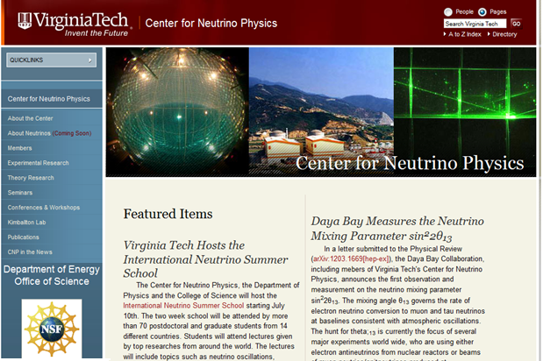
Virginia Tech
Center for Neutrino Physics

Slide 4
Virginia Tech
Center for Neutrino Physics
Faculty (with focus on neutrinos)
Bruce Vogelaar
Jon Link
Camillo Mariani
Important Events
“International Neutrino Summer School” (2012)
“Sterile Neutrinos at the Crossroads” (2011 workshop)
Center for Neutrino Physics (established 2011)
Principle Topics
Borexino (since inception)
LENS (since inception)
Daya Bay
MiniBooNE
Double Chooz
LBNE
Tatsu Takeuchi (theory)
Patrick Huber (theory)
Raju Raghavan (th. exp.) (recently deceased: Oct 2011)
VT Neutrino Funding
NSF (1999) $5.8M
DOE (2006) $2.0M

Slide 5
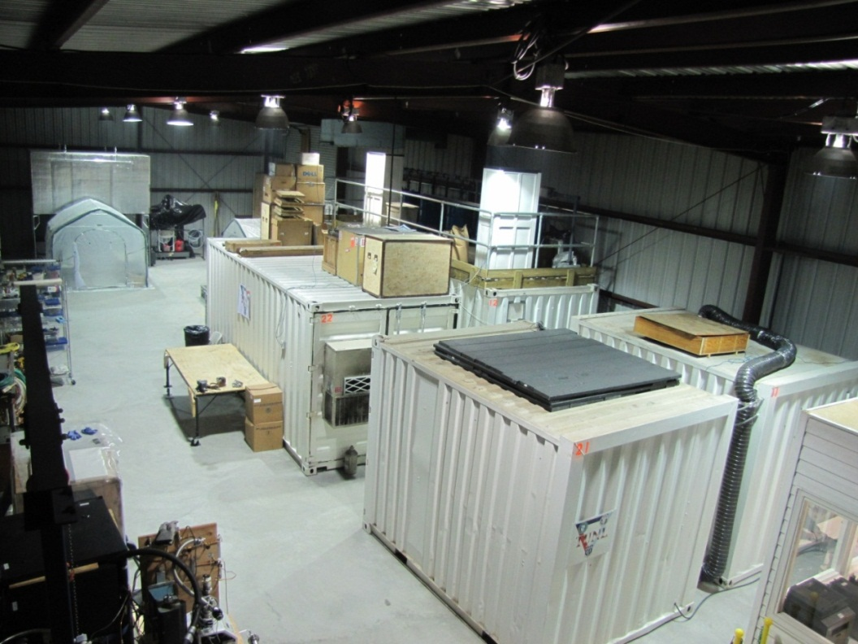
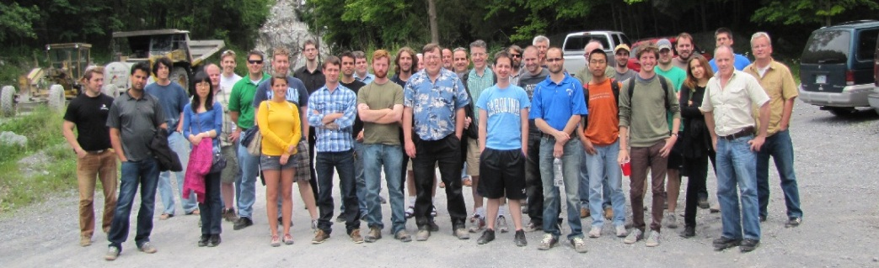
Virginia Tech
Kimballton Underground Research Facility
1400 m.w.e.
mini-LENS (Low Energy Neutrino Spectroscopy)
Neutron Spectrometer
ββ Decay to Excited States
HPGe Low-Bkgd Screening
MALBEK (Majorana 0νββ)
³⁹Ar Depleted Argon
Office
A
B
C
E
D
G
F

Slide 6
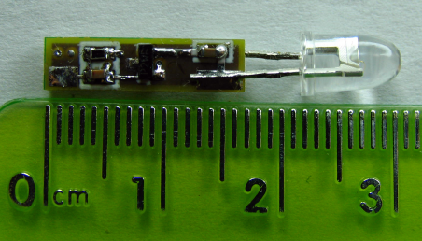
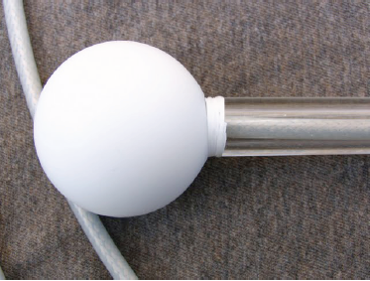
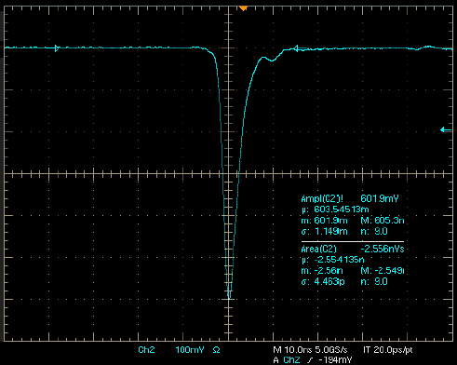
Daya Bay µ Veto
Jon Link and his team was responsible for the Water Pool calibration System
Relative timing of all PMTs;
Monitoring water quality;
Monitor PMT gains;
Light Pulse as Viewed by a PMT
3 ns rise time
3 ns FWHM
150 LED flashers;
Teflon diffuser balls optimally distributed giving uniform light to all the PMTs;

Slide 7
Borexino Detector

Slide 8
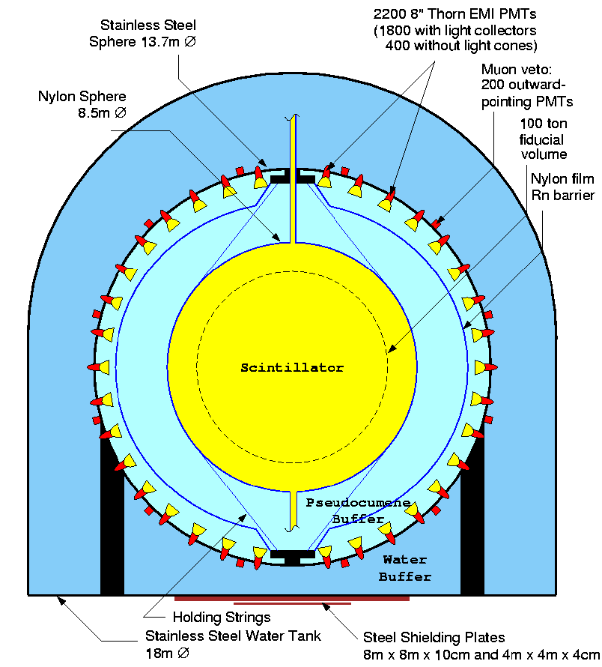
Borexino Detector
Design
Graded Shielding
Real-time Spectroscopy
2214 PMTs
Ultra-pure Target
PC + PPO (²³⁸U / ²³²Th ~ 10⁻¹⁸ g/g)
Neutrino Physics via
Electron Elastic Scattering
Resolution at 1 MeV:
5% [energy]; ~ 10-15cm [position]
Muon rejection: Efficiency > 99.992%

Slide 9
Major Publications
Pep & CNO limit : Phys. Rev. Lett. 108 (2012) 051302.
⁷Be Adn: Physics Letters B 707 (2012) 22-26.
⁷Be @ 5%: Phys. Rev. Lett. 107 (2011) 141302.
⁸B > 3 MeV: Phys. Rev. D 82 (2010) 033006.
Solar antinu limits: Phys. Lett. B 696 (2011) 191-196.
⁷Be @ 10%: Phys. Rev. Lett. 101 (2008) 091302.
⁷Be @ 17%: C. Arpesella at al. (Borexino collaboration):

Slide 10
Detector Calibration

Slide 11
Detector Calibration
Goals Constrains
• Determination of the energy scale;
• Study of the uniformity of the detector response;
• Study of FV systematics at different energies and for different FV cuts;
• Validation of the Borexino Monte Carlo code and of the analytical models that are used in the analysis to describe the detector response;
• Study of the detector trigger efficiency regarding ¹⁴C and ⁸⁵Kr bkg;
• The purity of the scintillator;
• Determination of the source
source position better than 2 cm;
• Spectral shapes must represent the internal backgrounds;
• Cost, simplicity and performance
combined with versatility of the
calibration sources (alpha, beta,
gamma, laser etc.);
• The access pipe only 10 cm in diameter;

Slide 12
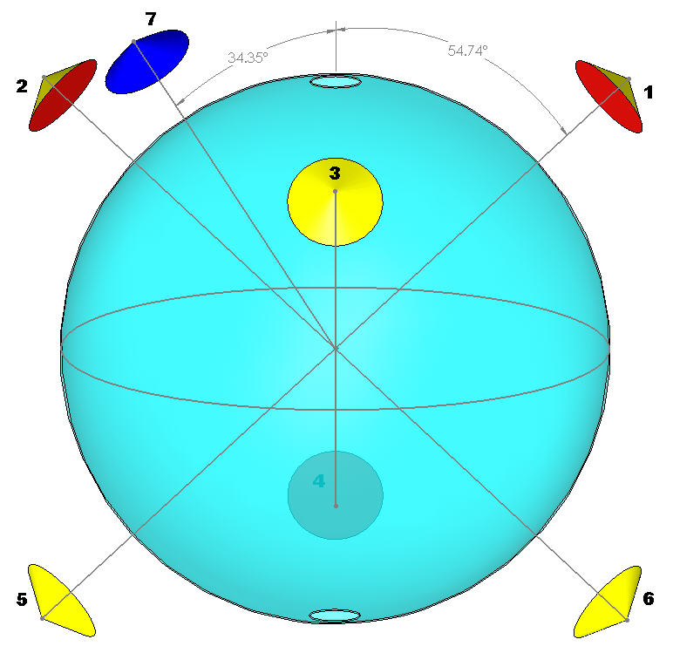
Hardware System
Source Location and Insertion
• 7 consumer-grade Kodak cameras;
• PMT positions used as reference pnt;
• Source position determined with
an additional LED;
• 1-m neutrally buoyant rods;
• Operated in Class-10 glove-box;
• 95% of the detector volume
covered;

Slide 13
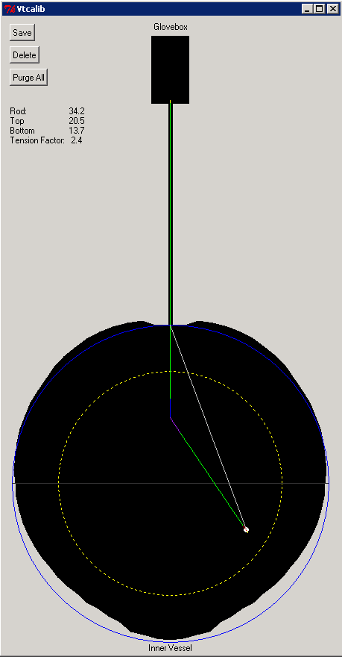
Hardware System
Source Location and Insertion

Slide 14
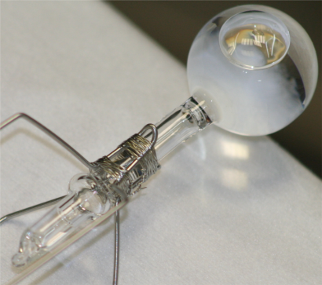
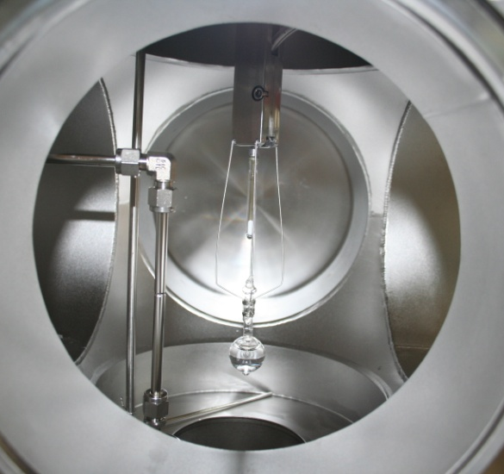
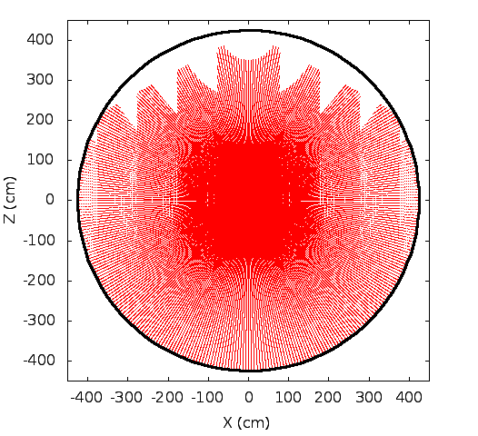
Source Insertion System
• One rod has a hinge in the center; Spring-mounted source is at the end;
• Teflon tube containing fiber optic is used to pull assembly off axis;
• 6-way cross couples gate valve to glovebox;
• Sliding seals for rod and tether maintain cross-glovebox ∆q;
Computer controlled process system:
• Maintains N₂ pressure & flow
• Monitors O₂ and liquid levels

Slide 15
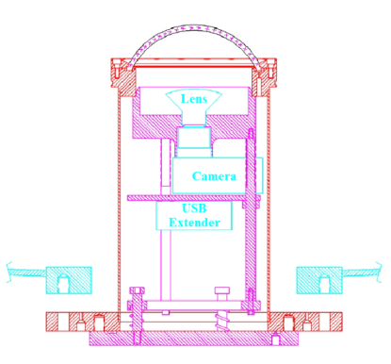
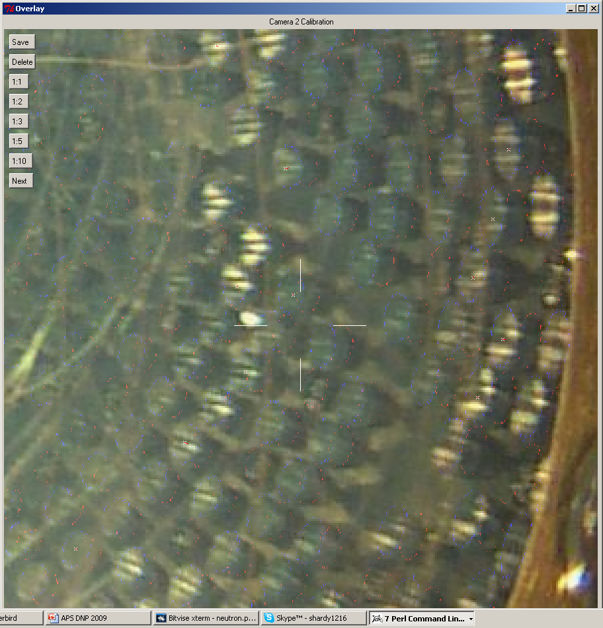
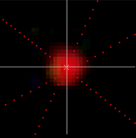
Source Location System
• Remote controlled
• Fitted with separate fish-eye lens
• Halogen bulbs for illumination
• Known PMT positions for self-calibration
• Pinhole LEDs used to account for scale + offset in subsequent images
• Searches red pixels in each image for “bright spot”
• Discard cameras with > 2 cm distance from fit position (min 2 CCDs required)

Slide 16
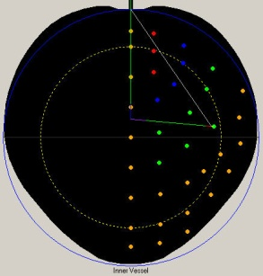
Calibration Campaigns
• 4 campaigns Oct ’08, Jan ’09, Jun ’09, Jul ’09;
• 12 different sources;
• 295 different locations;
• 54 days with 65 % duty cycle;
Type | γ |  |  |  |  |  |  |  | β |  | α | n
Src. | ⁵⁷Co | ¹³⁹Ce | ²⁰³Hg | ⁸⁵Sr | ⁵⁴Mn | ⁶⁵Zn | ⁶⁰Co | ⁴⁰K | ¹⁴C | ²¹⁴Bi | ²¹⁴Po | n-p | n-¹²C | n-Fe
MeV | 0.122 | 0.165 | 0.279 | 0.514 | 0.834 | 1.1 | 1.1, 1.3 | 1.4 | 0.15 | 3.2 | 7.69 (0.84) | 2.23 | 4.94 | ~7.5

Slide 17
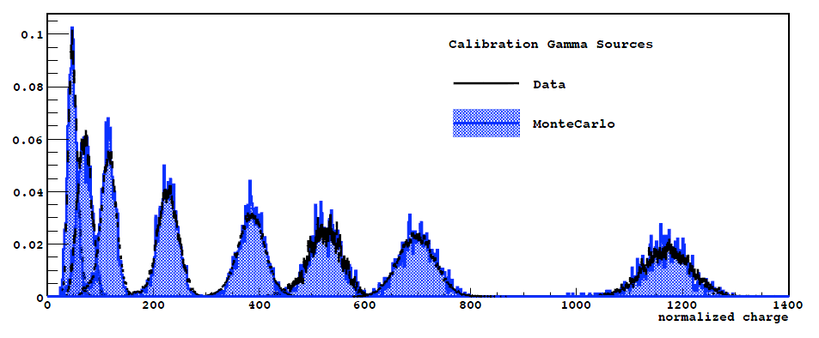
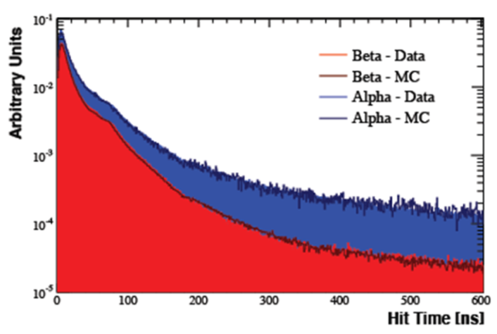
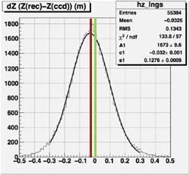
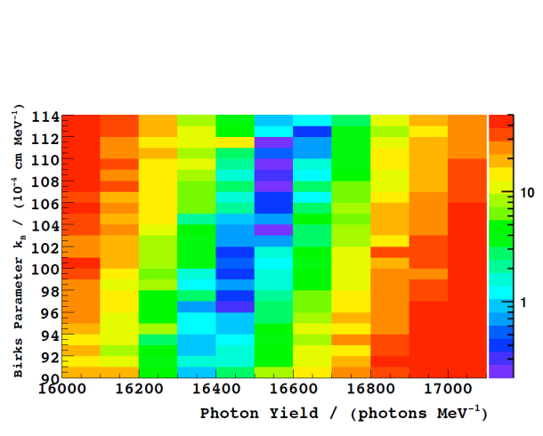
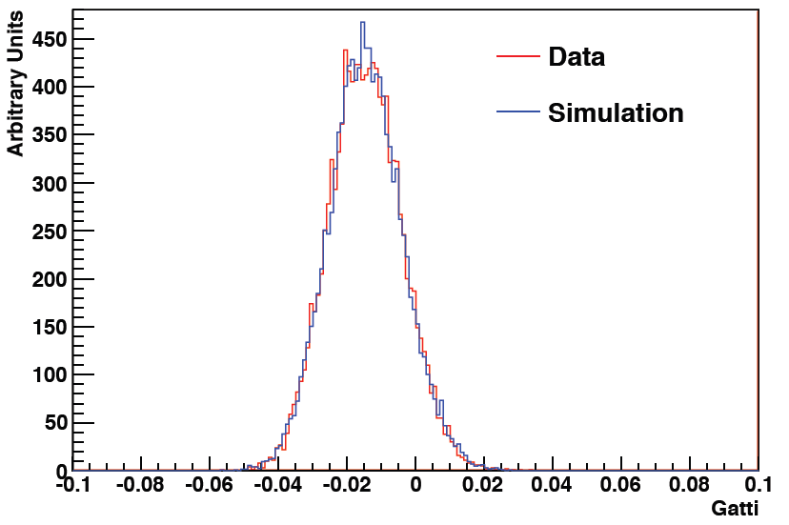
Calibration Results
Energy Scale
Pulse Shape
•
Position
Quenching
Gatti Parameter
β- events
and
α- events
β
α

Slide 18
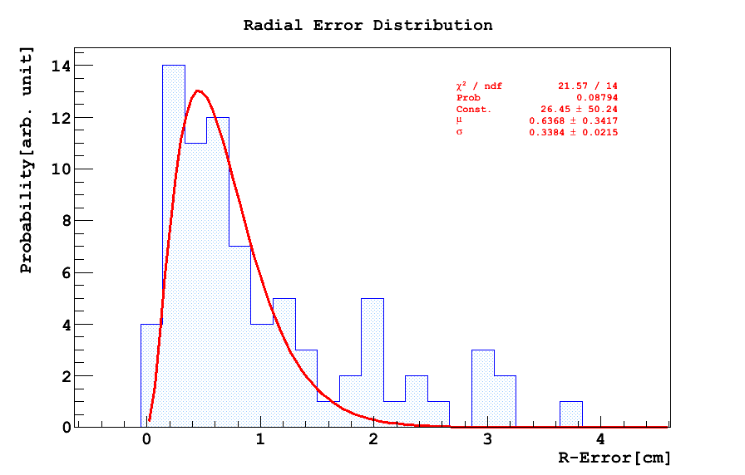
Calibration Results
• Room for improvement:
Position Reconstruction + 1.3, -0.5 %
Energy Scale ± 2.7%
Systematics
Livetime | 0.1% | 0.04%
Scintillator ρ | 0.2% | 0.05%
Event Selection Loss | 0.3% | 0.1%
Position Reconstruction | 6.0% | +1.3%/-0.5%
Energy Scale | 6.0% | 2.7%
TOTAL | 8.5% | +3.6%/ -3.4%
± 0.6 cm
Original goal ± 2 cm
• The system can be used at any point:
Required manpower – 30 members (full campaign)
Short campaigns also considered (Radon, laser sources)

Slide 19
Conclusions
• Calibration software and hardware developed and built at Virginia Tech;
• System was used in multiple campaigns and proved to be highly reliable;
• For Borexino, radiopurity in the region of interest was of major concern
but no long-term contamination due to calibrations has been identified;
• Systematic errors in Borexino were reduced by more than a factor of 2;
• Large operational range allowed to study the energy reconstruction uniformity;
• The system remains on site, ready for immediate implementation;
Currently awaiting the end of data-taking phase II in Borexino .

Slide 21
Backup

Slide 22
Position Reco
Mechanical Ruler Check

