Slide 1
Photomultiplier Tube Glass Failure in Neutrino Detection: Challenges and Opportunities
S. K. Sundaram Multifunctional Materials Laboratory (M&M-Lab)
Kazuo Inamori School of Engineering The New York State College of Ceramics Alfred University, Alfred, NY 14802
M. Diwan
Brookhaven National Laboratory
Upton, NY 11973
Contributors: AU - Kameron Chambliss and Ruhil Dongol
BNL - Athena Marneris, Ken Sexton, and Rahul Sharma
Multifunctional Materials Laboratory
(M&M-Lab)
The Sundaram Group

Slide 2
Outline
Introduction
Major challenges
Our objectives
Our approach
PMT Glasses
Composition
Preparation
Selected Results
Vickers hardness
Ring-on-ring biaxial flexural strength test
Crack velocity measurement
Summary and Conclusion
Future Plan and Opportunities
Acknowledgment
2

Slide 3
Major Challenges
Photomultiplier tube (PMT) glasses will be submerged at a water depth of ~80 meters under pressure up to 880 MPa at 14ºC, exposed to high purity water corrosion for about 20 years.
New PMT bulb design is considered for the Long Baseline Neutrino Experiment Collaboration (LBNE).
There is limited glass strength/fracture mechanics data on PMT glasses (particularly data for service under the conditions for expected LBNE campaign period) and also on chemical durability of PMT glasses
There is no correlation between chemical durability and fracture mechanics developed for the PMT glasses.
Full prototypic testing is cost prohibitive.
We need to collect basic datasets to perform required statistical analysis to predict the time to failure accurately.
3

Slide 4
Our Objectives
To conduct comprehensive study of fracture mechanics of selected PMT glasses
To predict lifetime of PMT glass under the neutrino detection conditions
To investigate new glass compositions with superior properties for better detection
4

Slide 5
Our Approach
We used vendor glasses. We combined laboratory measurements and prototypic testing to evaluate these glasses.
Laboratory measurements (Alfred University)
Basic glass properties
Flexural strength
Vickers hardness testing
Ring-on-ring equibiaxial flexural strength testing
Chemical durability of the glasses
Proof-testing
Prototypic testing of PMTs (Brookhaven National Laboratory)
Crack velocity measurements
5

Slide 6
PMT - Composition
The nominal compositions of two vendor glasses fall in the following ranges: Sodium borosilicate glass composition
Na₂O gives flexibility in melting temperature
ZnO reduces the “misty” and “milky” formation in PMT glass*
Vendor glasses: #1 ETL and #2 Hamamatsu
Oxide | SiO₂ | Na₂O | Al₂O₃ | ZnO | BaO | CaO | B₂O₃
Weight Percent | 65-70 | 6-9 | 4-7 | 0-3 | 0-3 | 0-1 | 15-18
* Corrosion in Glass Windows in DIRC PMTs – P. Bourgeois and J. Va’vra
6

Slide 7
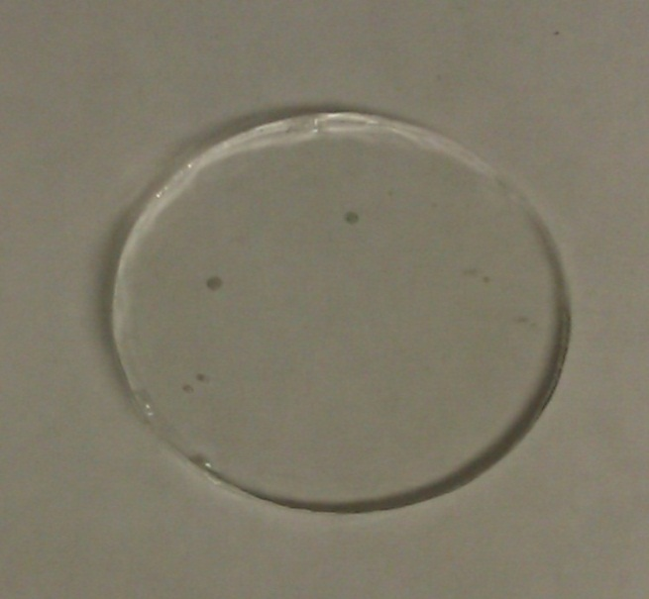
PMT Glass Sample Preparation
Melt at 1450°C for 12 hours in a platinum crucible
Anneal at 550°C for 1 hour
Grinding Process
Average Grain size in µm 45.2, 30.4, 20.9, 14.0, 9.2, 6.2
3-5 min on either side
Polishing Process
Diamond suspension polycrystalline
3µm and 0.25µm
7

Slide 8
Results – Vickers Indentation
200g Indent
300g Indent
500g Indent
1000g Indent
8

Slide 9
Results – Vickers Indentation
Vendor glasses: #1 ETL and #2 Hamamatsu
Schott Supermax® 33 Rolled Borosilicate Glass has Vickers Hardness of 568.
http://www.us.schott.com/supremax/english/product_properties/index.html
9

Slide 10
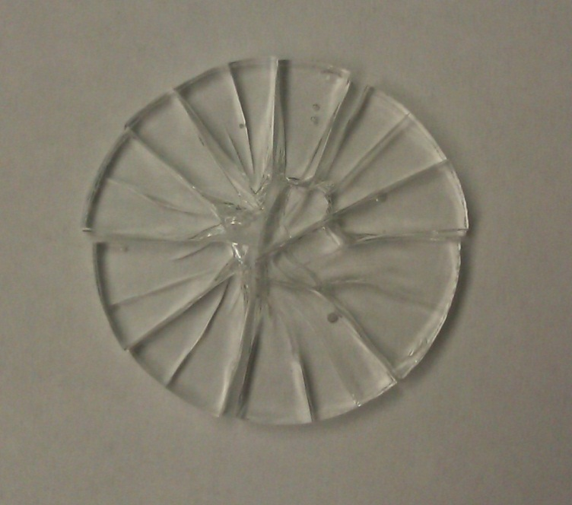
Results – Ring-on-Ring Test
Equibiaxial strength, σ_{f} , of a circular plate in units of MPa is
$σf=\frac{3F}{2πh2}[\left(1−ν\right)\frac{DS2−D_{L}2}{2D2}+\left(1+ν\right)ln\frac{Ds}{DL}]$
Where F is breaking load in N
10

Slide 11
Results – Ring-on-Ring Test
Vendor1 Sample | Diameter (mm) | Thickness (mm) | Breaking Load (N) | Equibiaxial Strength (MPa)
1 | 29.60 | 3.192 | 1415.81 | 89.5
2 | 29.65 | 3.015 | 1045.38 | 74.0
3 | 29.82 | 2.735 | 1073.84 | 92.2
4 | 29.65 | 3.117 | 1378.42 | 91.3
Vendor2 Sample | Diameter (mm) | Thickness (mm) | Breaking Load (N) | Equibiaxial Strength (MPa)
1 | 29.77 | 2.368 | 738.14 | 84.1
2 | 29.725 | 2.763 | 1156.65 | 96.8
3 | 29.755 | 2.473 | 702.38 | 73.4
4 | 29.82 | 2.719 | 1105.21 | 95.5
5 | 29.675 | 2.793 | 1094.73 | 89.8
Vendor glasses: #1 ETL and #2 Hamamatsu
Equibiaxial Strength for borosilicate glass range is 46 – 1350 MPa.
*http://www.dtic.mil/dtic/tr/fulltext/u2/a546252.pdf
11

Slide 12
Results – Implosion Tests
Several implosion tests of PMTs of different diameters from the vendors were completed at BNL. These test results (summarized in the next slide) were used to estimate crack velocity.
At AU, the slow motion videos were reviewed frame-by-frame and visible cracks were measured in each frame. These distances were scaled to the known diameter of the bulb and the frame-rate of the video was used to calculate a velocity for each crack.
Selected images of a couple of implosion tests are also shown in the following slide. Cracks that are evolving and being measured in the current frame are indicated with red arrows. Cracks that have been measured are marked in blue.
12

Slide 13
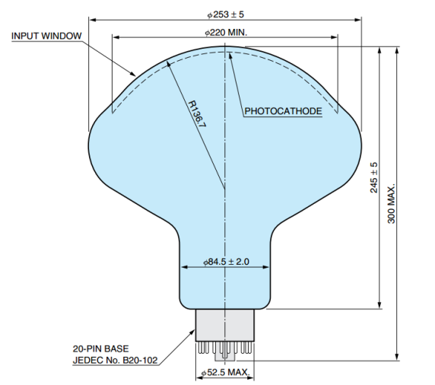
Results – Summary of Implosion Tests
5 minutes rise
2 hours rise
Hamamatsu 10” PMT Drawing
24 hours rise
13

Slide 14
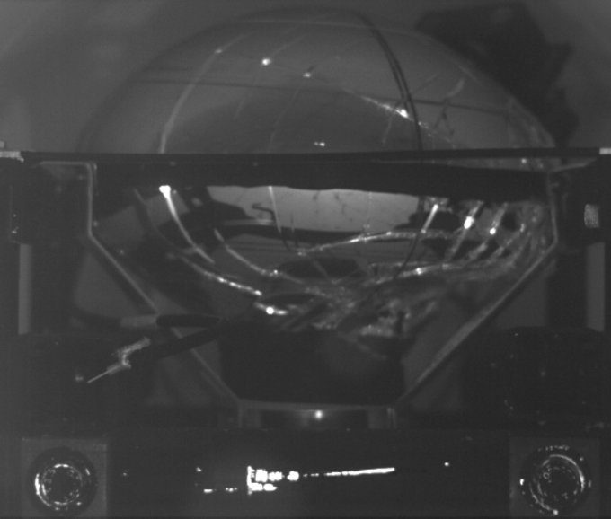
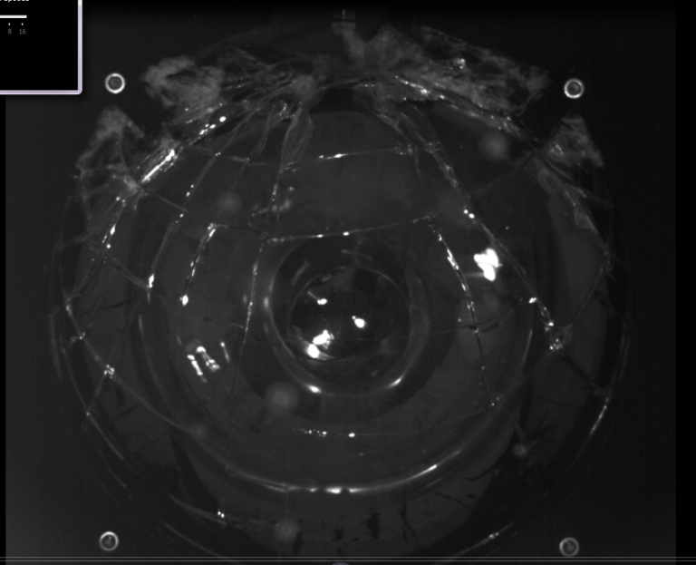
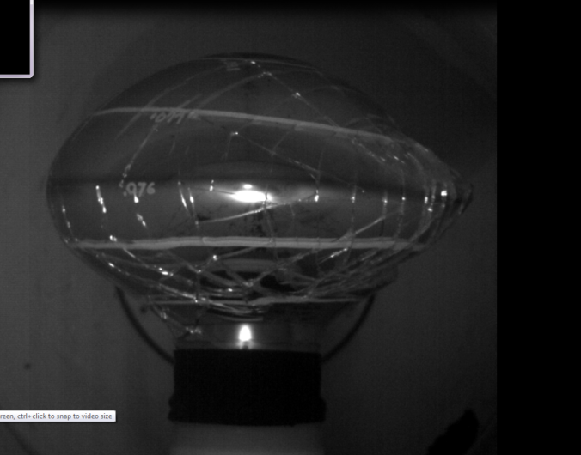
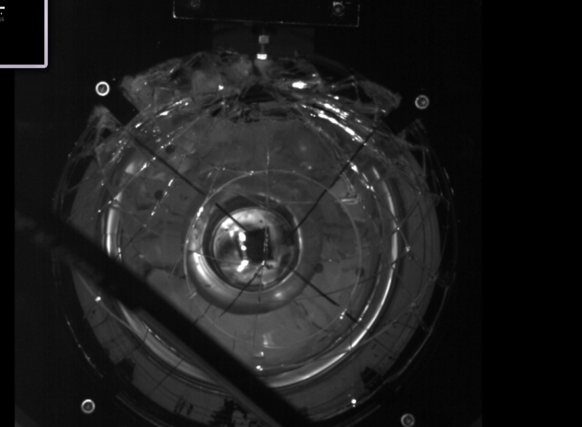
Results – Crack Velocity
Frame 6
Frame 10
5000 fps
4800 fps
Crack #4
RA0227
RA0246
Frame 5
Frame 10
6000 fps
6000 fps
TA3610
TA3281
14

Slide 15
Results – Crack Velocity
In all, thirteen individual cracks were measured in the four different bulbs and an average velocity of 184.6 m/sec was calculated with a standard deviation of 58.7 m/sec
Bulb Designation | Pressure at Break (psi) | # of Cracks Measured | Average Crack Velocity (m/sec) | Standard Deviation (m/sec)
RA0246 | 260 | 4 | 191.91 | 63.70
RA0227 | 269 | 1 | 192.26 | --
TA3610 | 205 | 3 | 239.20 | 57.08
TA3281 | 103 | 5 | 144.35 | 36.52
Our data indicate large variations in the mechanical properties due to differences in flaw populations in the PMT bulbs, underlining the need for more systematic fracture mechanics testing.
15

Slide 16
Summary and Conclusion
Vickers hardness numbers for both vendor glasses are comparable to known borosilicate glass hardness and show a non-linear decreasing trend as expected. Hardness values for Vendor 2 glass decreased considerably for sample treated in high purity water exposure test for 5 days
Hydrolytic process may be responsible for the dramatic decrease in hardness number for Vendor 2.
Equibiaxial Strength results show comparable values to literature values of borosilicate glass hardness
Crack velocities measured are much higher than the values reported for common glasses.
Extensive testing is required to understand the fracture of these glasses and predict their failure.
16

Slide 17
Future Plan and Opportunities
We seek to develop and understand a more complete picture of the flexural strength of these glasses, via a full series of static fatigue measurements in dry air and high-purity water.
We plan to use vapor hydration testing (designed originally to evaluate nuclear waste glasses) for accelerated testing of PMT glasses for chemical durability.
We will use proof testing to determine the time for failure data at required confidence level. Selected segments of the PMT bulbs will be used for proof-testing and statistical analysis.
Our results will advance the detection science:
A predictive relationship that is useful in discovery of new materials
Improved glass composition for advanced neutrino detection.
17

Slide 18
Acknowledgement
Thanks for your time – I welcome your questions and comments
Kyocera Corporation for the support of Inamori Professorship (SKS)
Dean Doreen Edwards, Kazuo Inamori School of Engineering for support
Prof. Kathleen Richardson, Clemson University for part of travel support
Brookhaven National Laboratory for project support
18

