Slide 1
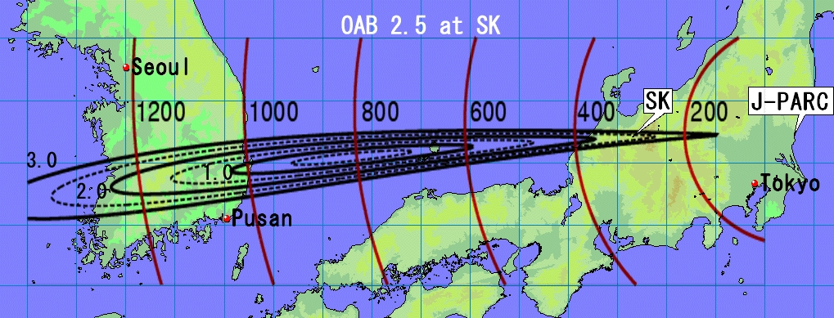
Proposal for the 2nd
Hyper-K detector in Korea
Sunny Seo
Seoul National University
Mark Hartz (IPMU), Yoshinari Hayato (ICRR), Masaki Ishitsuka (TIT), Soo-Bong Kim (SNU),
Akira Konaka (TRIUMF), Sunny Seo (SNU), Masato Shiozawa (ICRR), Shoei Nakayama(ICRR),
Hirohisa Tanaka (U.Toronto), Mike Wilking (Stony Brook)

Slide 2
Overview
Short Introduction & Motivation
Quick Summary of 3 T2KK workshops (2005-2007)
What is T2HKK ?
Updating sensitivity studies for T2HK, T2HKK
Candidate Sites in Korea
Plans & Strategy
Summary & conclusion

Slide 3






θ₁₃ and Future Experiments
Accelerator
Reactor
MO
θ₁₃ ≈ 9º
2012
RENO-50
MO & δ_{CP}
MO = Mass Ordering
MO
MO & δ_{CP}
PINGU
ORCA
Atmosphere

Slide 4

Two ways to measure δ_{CP}
1. Asymmetry between ν and ν: Hyper-K (0.63 GeV +/- 20%)
-- narrow band (off-axis) beam can control πº BG.
-- need good control of sys. errors between ν and ν data.
2. Spectral shape of ν_{e} spectrum: DUNE (1 – 5 GeV)
Investigate position and amplitude of 1st and 2nd osc. min., max.
with wide band ν beam at long baseline.
→ good energy resolution is needed at 2nd osc. max.
** appearance channel looks dominated by beam BKG in DUNE
at 2nd osc. max.
Notes:
Do not understand these plots: CP interference
What systematics ?

Slide 5







Slide 6
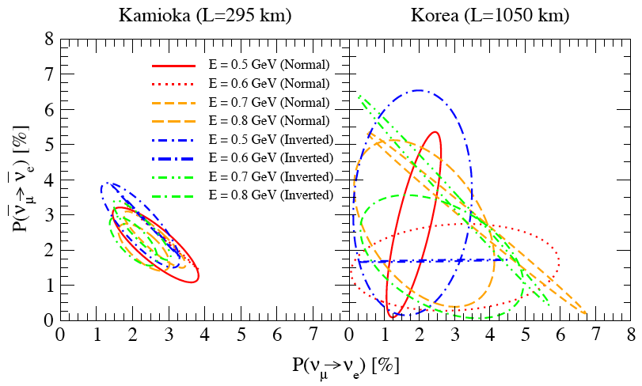
Relatively large θ₁₃ ~ 9º allows us to explore δ_{CP} better
in the 2nd oscillation max. at large L/E.
Sin²(2θ₁₃) = 0.05
Almost Same background
Same OAB = 2.5º
For large θ₁₃, signal systematics is a limiting factor at the 1st oscillation maximum.
signal statistics is a limiting factor at the 2nd oscillation max.

Slide 7
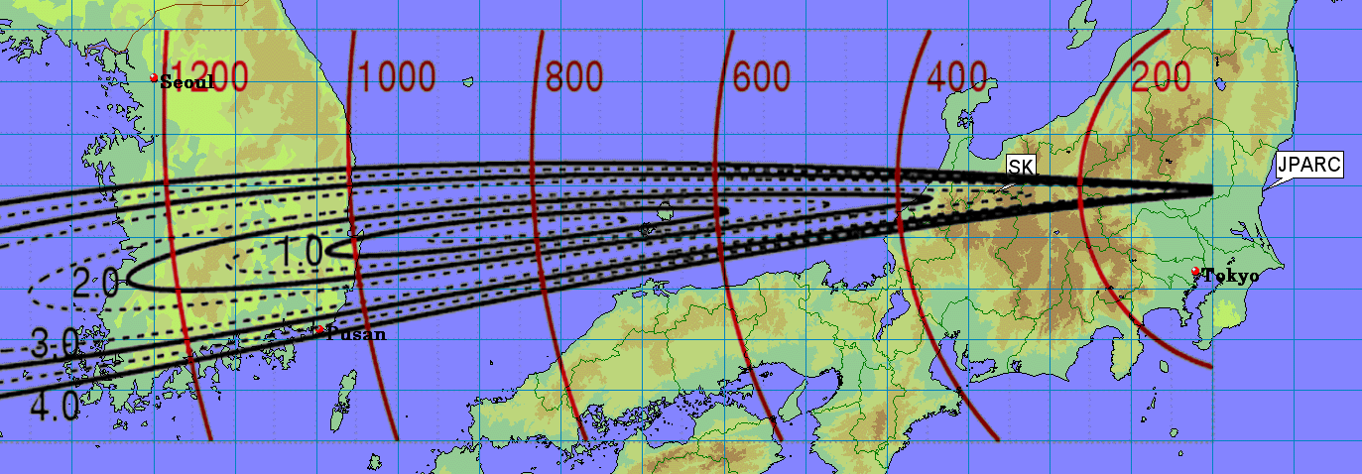
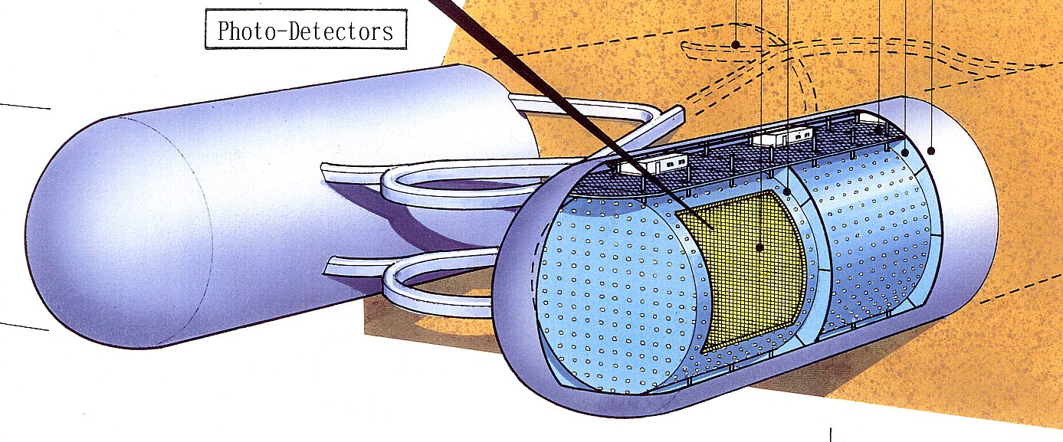
Motivation of
the 2nd Detector in Korea
Instead of Hyper-K (0.25 + 0.25 Mt) alone w/ 2.5º OAB,
HK(0.25 Mt) w/ 2.5º + Korean Detector (0.25 Mt) w/ 1~3º OAB
will improve δ_{CP} and mass ordering measurements.
Because oscillation parameter degeneracy is resolved.
(Different baseline and matter effects etc…)

Slide 8
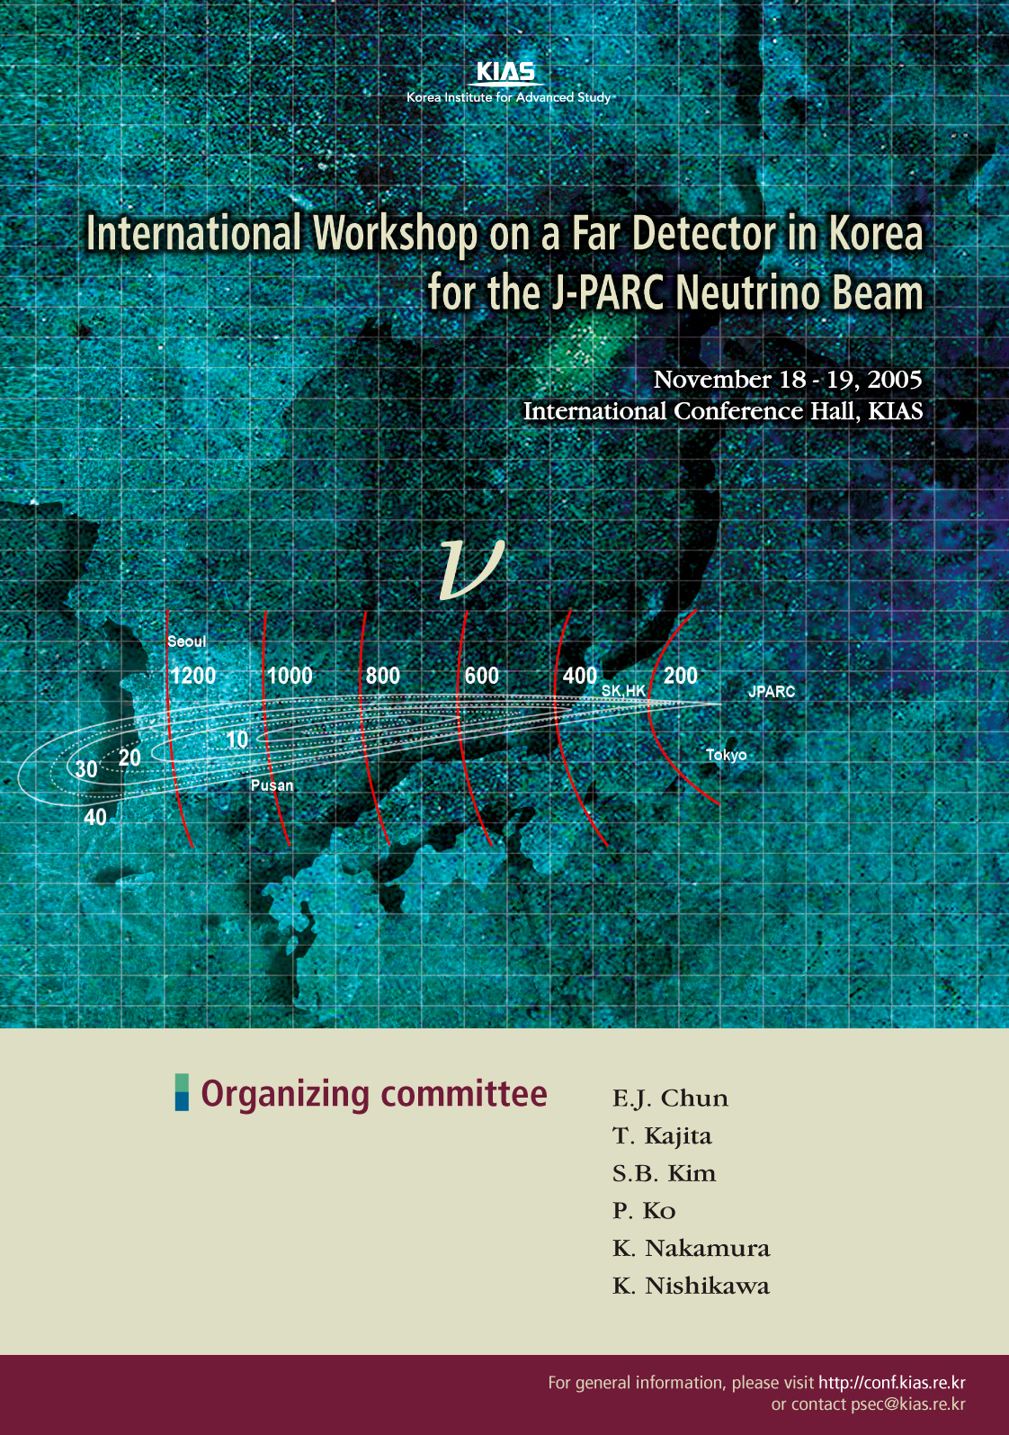
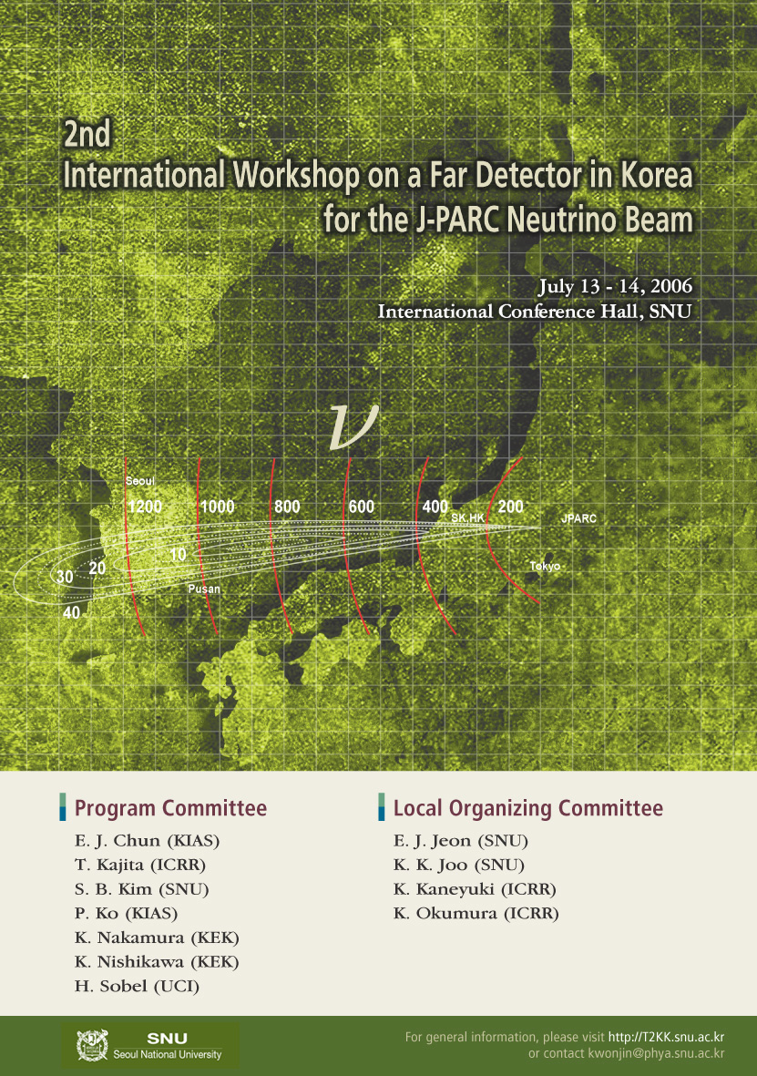
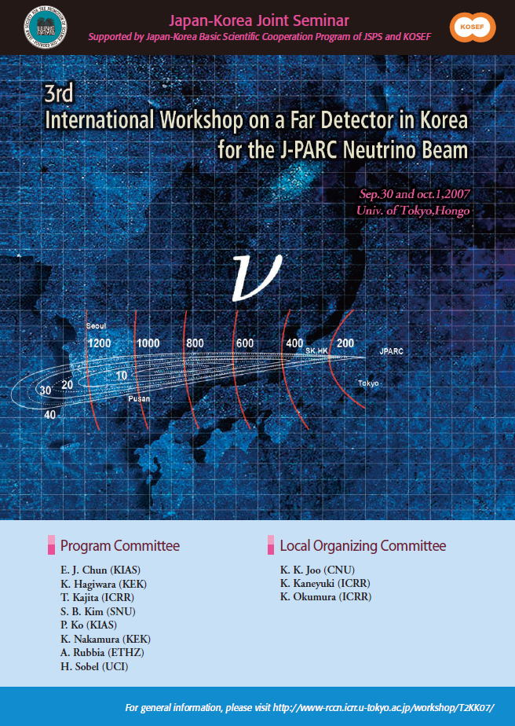
Past Three T2KK Workshops
2005
KIAS
2006
SNU
2007
U. Tokyo

Slide 9
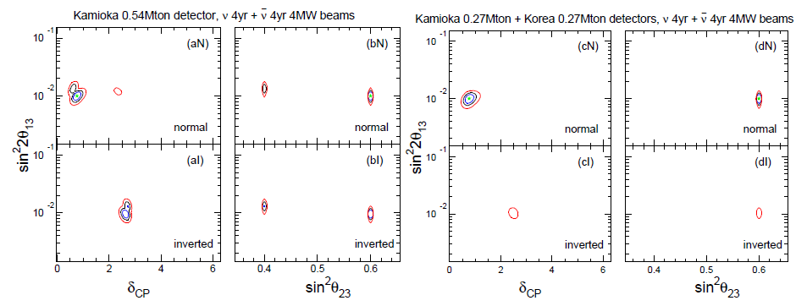
Resolving the degeneracy: T2K-II vs. T2KK
T2K-II (0.54 Mt) vs. T2KK(0.27+ 0.27 Mt)
Mass hierarchy not determined
Octant of θ₂₃
not resolved
T2KK has a good sensitivity to resolve the parameter degeneracies.

Slide 10
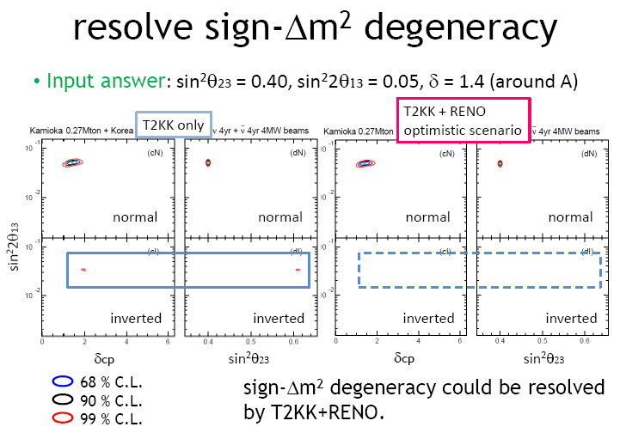
Sensitivity of Mass Ordering
C. Ishihara, T2KK07

Slide 11
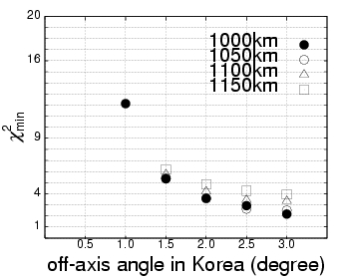
MO sensitivity vs. off-axis angle @Korea
N.Okamura, T2KK05/07
Suggested that the higher energy beam is better due to the larger matter effect.
1.0 to 3.0 degree off-axis beam available in Korea.
True:
Normal Mass Ordering
Sin²(2θ₁₃) = 0.1, δ_{CP} = 0
However, background might be a serious issue for higher energy beam.
Detailed Monte Carlo study (F.Dufour, T2KK06)
Liquid Argon detector (A.Rubbia, T2KK05/06)

Slide 12
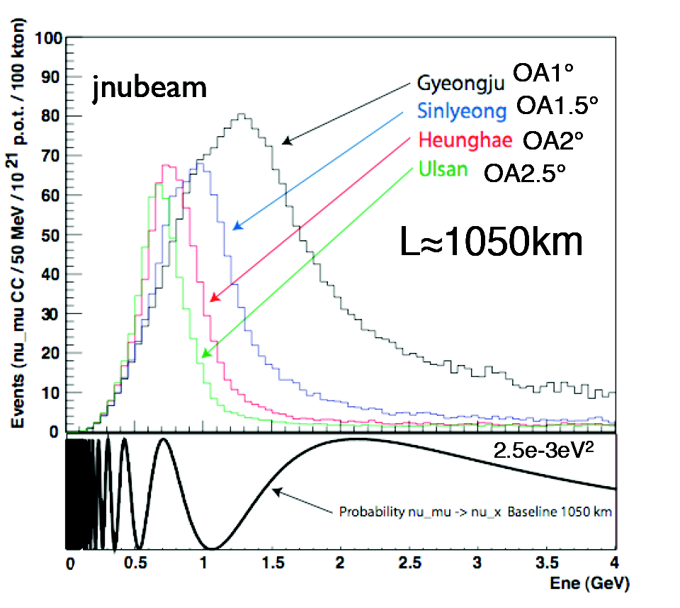
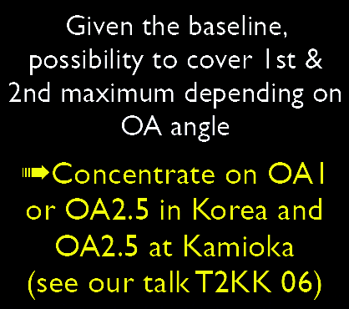
Beam Energy Profiles at Korean Sites
A. Rubbia, T2KK07
1.0 to 3.0 degree off-axis beam available in Korea.

Slide 13
Sensitivity on Korean Detector Baseline
K. Okumura, T2KK06
2.5 degree off-axis beam with L between
1,000km and 1,250km is available.
Kamioka only
L=1000km
L=1050km
L=1100km
L=1150km
L=1200km
sin²2θ₁₃
L=1250km
The sensitivity does not depend strongly on L !
Potentially many candidate sites !
3 σ sensitivity to mass hierarchy
(True = normal hierarchy)
δ

Slide 14
Signal & BG for Various Off-axis Beams
F.Dufour, T2KK06
Kamioka
Korea
1.0 degree
1.5 degree
2.5 degree
signal
signal
BG
BG
sin²(2θ₁₃)=0.1 δ=1/2π
4 year neutrino run
4MW beam
2.0 degree
2.5 degree
Smaller off-axis angle:
Larger matter effect at the 1st osc. Max..
➔ Low E BG more serious.
(2nd osc. Max. difficult to see.)

Slide 15
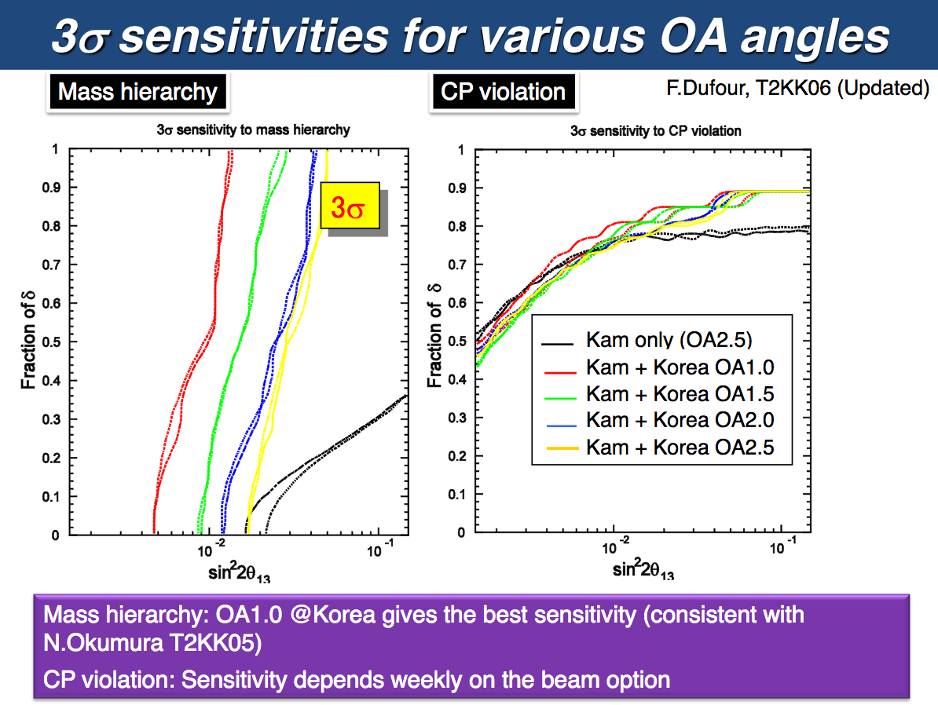
3σ Sensitivities for Various OA Beams
Mass Ordering
CP violation
Mass ordering: OAB 1.0 @Korea gives best sensitivity (consistent with N.Okumura T2KK05)
CP violation: sensitivity depends weakly on the beam option

Slide 16
Then (~10year ago) & Now
Now we know θ₁₃ value precisely: relatively large
→ Detector can be smaller.
And other oscillation parameter values are improved.
Now better understanding of systematics.
Now we have better rejection of pi0 BKG
→ Need to update all these studies

Slide 17
What is T2HKK ?
Tokai-to-HK-to-Korea
The same meaning as T2KK but different naming.
Credit: updated sensitivity study in the following slides
is done by Mark Hartz (IPMU).

Slide 18
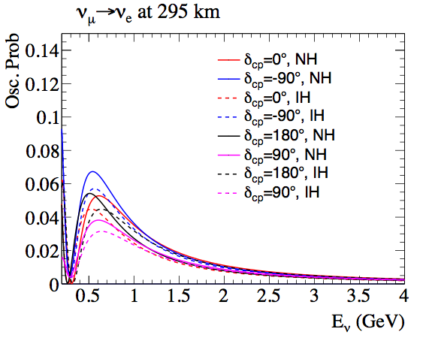
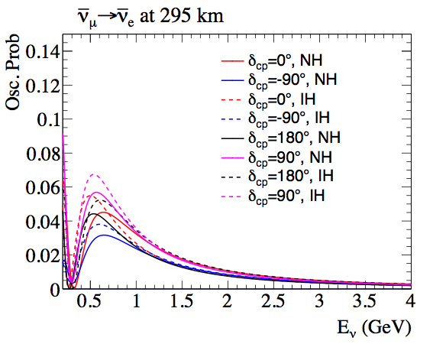
Oscillation Probabilities (295 km)
Using Prob3++ with constant matter density of 2.6 g/cm3
At 295km and the first oscillation maximum, IH and NH solutions are generally degenerate with solutions of the different hierarchy and δcp value

Slide 19
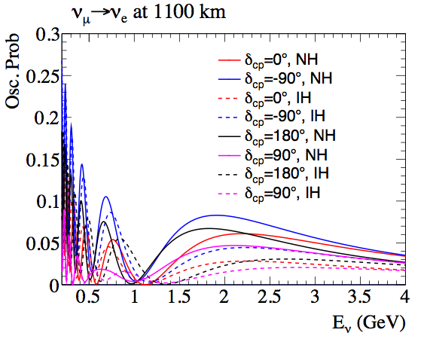
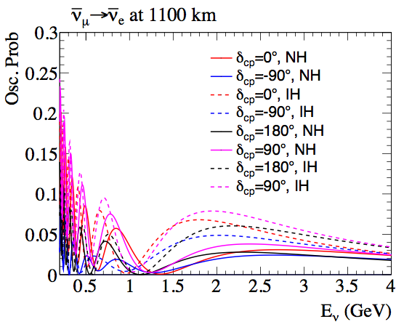
Oscillation Probabilities (1100 km)
Using Prob3++ with constant matter density of 3.0 g/cm3
mass hierarchy sensitivity from region between first and second maximum - should choose a more on-axis detector position than 2.5 degrees off-axis

Slide 20
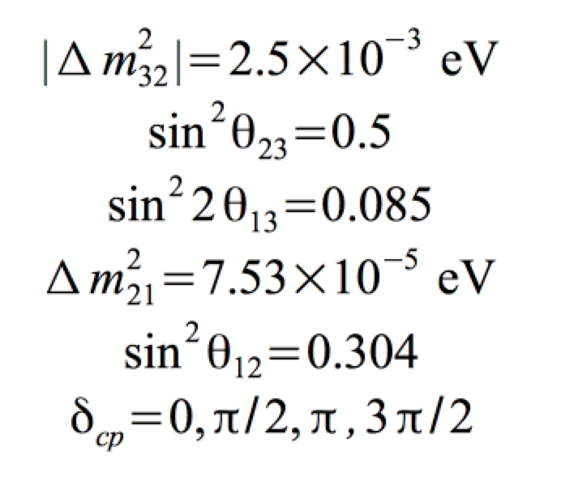
Event Rate Calculation
2.7e22 POT, 1:3 ν/ν-bar (FHC/RHC) operation ratio
187 kton fiducial volume (compared to 22.5 kton for SK)
Baseline to Korea is 1100 km
Oscillation parameters:
Notes:
2.7e22 POT = 10 years of data with 1.3 MW beam

Slide 21
295 km, NH (Erec < 1.2 GeV)
 | Signal | Wrong Sign Signal | Intrinsic νe | NC | CC-νμ | Total | S/B
FHC (δ=0) | 1884 | 20 | 357 | 165 | 9 | 2436 | 3.3
FHC (δ=-π/2) | 2370 | 14 | 357 | 165 | 9 | 2916 | 4.3
RHC (δ=0) | 1390 | 218 | 447 | 203 | 6 | 2264 | 1.6
RHC (δ=-π/2) | 989 | 262 | 447 | 203 | 6 | 1907 | 1.1
FHC = neutrino mode
RHC = antineutrino mode

Slide 22
1100 km, 1.5° OAB, NH (Erec<2.4 GeV)
 | Signal | Wrong Sign Signal | Intrinsic νe | NC | CC-νμ | Total | S/B
FHC (δ=0) | 180.1 | 2.8 | 45.4 | 47.6 | 4.8 | 280.6 | 1.8
FHC (δ=-π/2) | 307 | 1.2 | 45.4 | 47.6 | 4.8 | 405.8 | 3.1
RHC (δ=0) | 203.9 | 26.6 | 61.1 | 48.9 | 2.2 | 342.7 | 1.5
RHC (δ=-π/2) | 73.1 | 43.7 | 61.1 | 48.9 | 2.2 | 228.9 | 0.5
FHC = neutrino mode
RHC = antineutrino mode

Slide 23
1100 km, 1.5° OAB, NH (Erec < 1.2 GeV)
 | Signal | Wrong Sign Signal | Intrinsic νe | NC | CC-νμ | Total | S/B
FHC (δ=0) | 149.3 | 2.2 | 32.5 | 39.8 | 4.6 | 228.4 | 1.9
FHC (δ=-π/2) | 257.8 | 1.2 | 32.5 | 39.8 | 4.6 | 335.4 | 3.4
RHC (δ=0) | 192.5 | 15.6 | 39.8 | 41.4 | 2.2 | 291.6 | 1.9
RHC (δ=-π/2) | 64.9 | 27.4 | 39.8 | 41.4 | 2.2 | 175.9 | 0.6
FHC = neutrino mode
RHC = antineutrino mode

Slide 26
MO can be determined regardless of δ_{CP}.
Notes:
Multi-ring reco will enhance events above 1 GeV.
More on-axis will also enhance above 1 GeV.

Slide 27
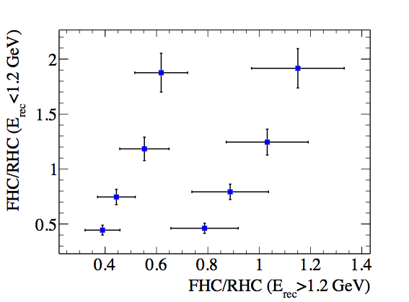
Comment on Event Rates
For 1100 km detector, hierarchy sensitivity appears to come from Erec>1.2 GeV region (matter effect), while CP sensitivity comes from the Erec<1.2 GeV.
Can visualize the rough sensitivity of the experiment by looking at the ratios of FHC/RHC (with statistical errors) for different values of δcp and hierarchy
δcp=3π/2, IH
δcp=3π/2, NH
δcp=π, IH
δcp=π, NH
Statistical Errors on Ratios
δcp=0, IH
δcp=0, NH
δcp=π/2, IH
δcp=π/2, NH
Notes:
MO: for the same L/E, bigger E is better.
dCP: bigger L/E is better

Slide 28
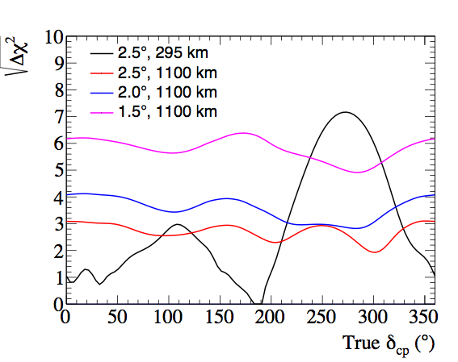
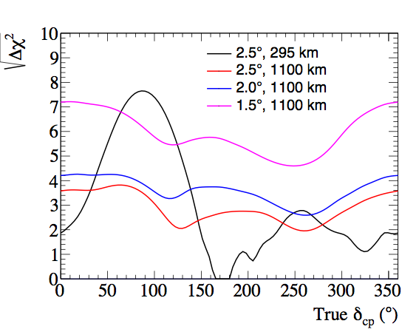
Mass Hierarchy Sensitivity, Single Detector
True NH
True IH
The 1.5 degree KD alone is over 5 “sigma” for almost all true values of δ and the hierarchy
  Dependence on true values of atmospheric parameters should also be tested
For HK, why is δ=0 more sensitive than δ=π?

Slide 29
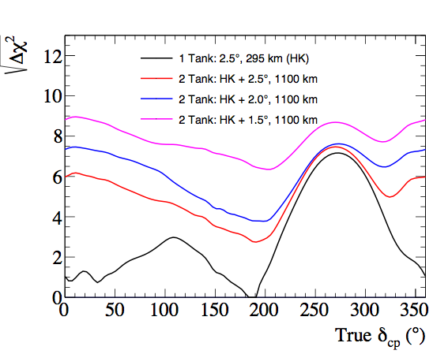
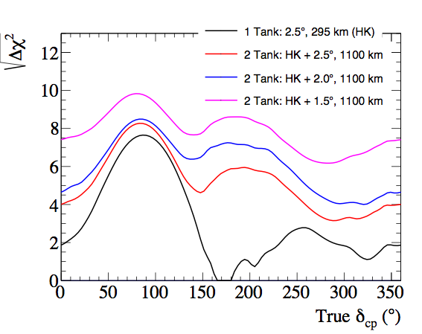
Mass Hierarchy Sensitivity, Two Detector
True NH
True IH
With two detectors, the 1.5 degree KD+HK is the only option giving over 5 “sigma” for all true values of δ and the hierarchy

Slide 30
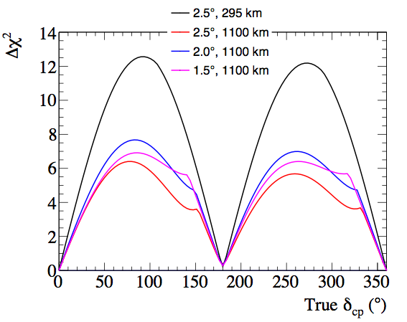
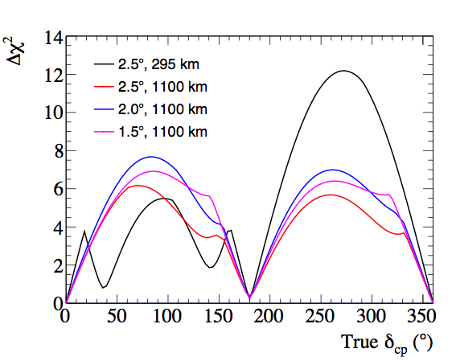
δcp Sensitivity, True NH
Known hierarchy
Unknown hierarchy
√Δχ²
√Δχ²
For the KD, the CP sensitivity does not depend too much on prior knowledge of the mass hierarchy
For HK, there is a degenerate region where the CP sensitivity is degraded if the hierarchy is not know
The 2.0 and 1.5 degree off-axis cases appear to have better CP sensitivity

Slide 31
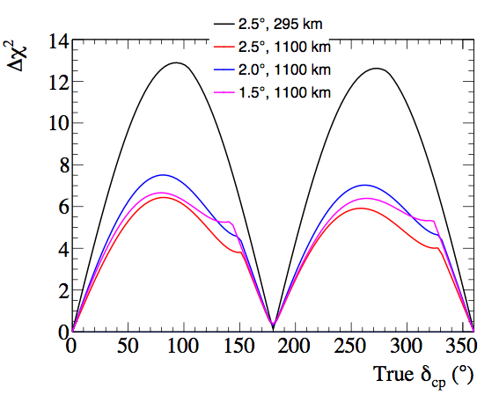
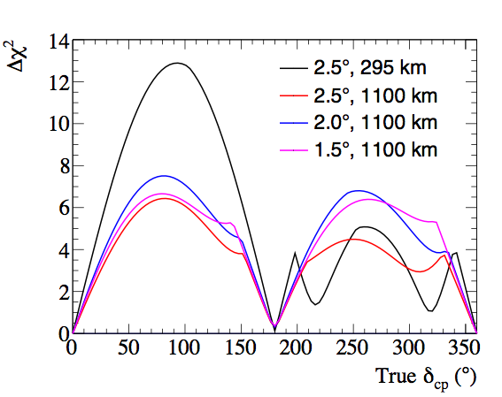
δcp Sensitivity, True IH
Known hierarchy
Unknown hierarchy
√Δχ²
√Δχ²
Same conclusions at the true NH case
The degenerate region for HK switches to 180-360 degrees
Expect “realistic” systematic errors to degrade the HK peak significance to ~8 sigma based on Hyper-K sensitivity calculations

Slide 32
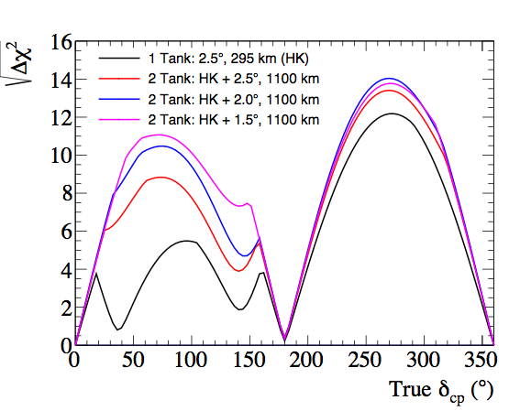
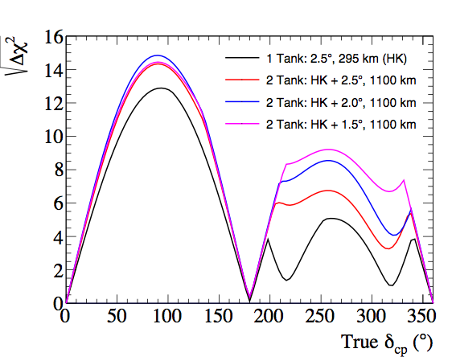
δcp Sensitivity, 2 Detectors
Unknown hierarchy
True NH
True IH
In combination with the HK detector, it looks like the KD at 1.5 degrees is best for ensuring 5 sigma significance over the widest range of δ values

Slide 33
T2HKK Sensitivity:
Near(0.5 Mt)-only
This study needs better understanding of systematics.
Hopefully soon…

Slide 34
Even a smaller (~100 kton fiducial) detector
in Korea would still enhance
δ_{CP} & mass ordering sensitivities.
arXiv: 1605.02368
Hagiwara et al.

Slide 35
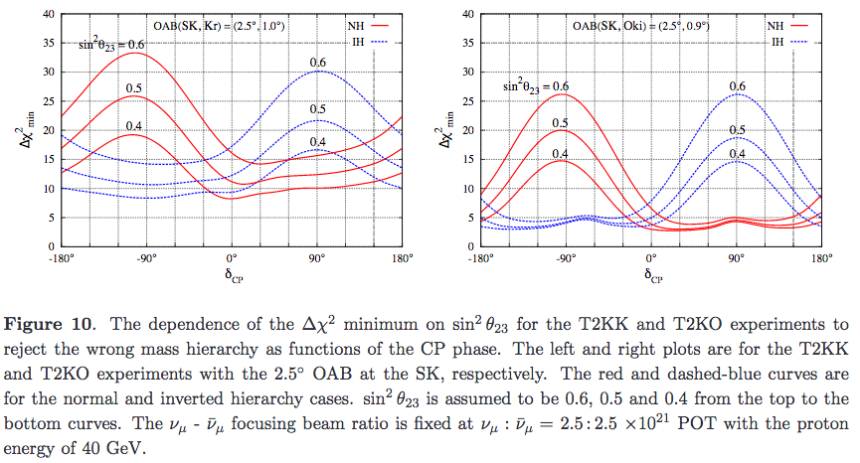
100 kton fiducial volume
arXiv: 1605.02368
Hagiwara et al.

Slide 36
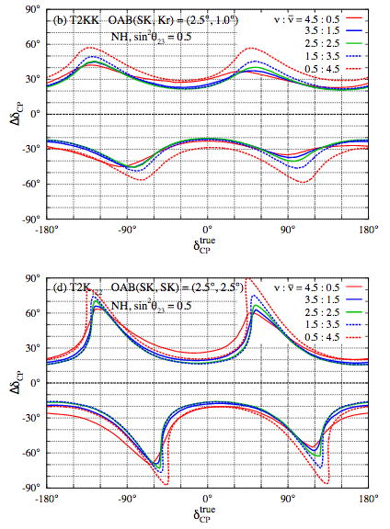
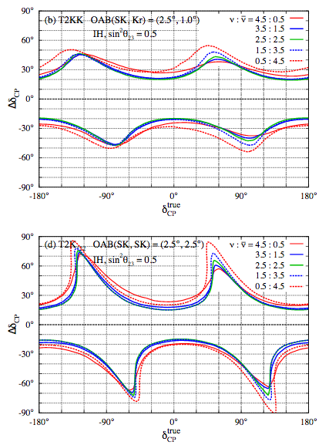
100 kton fiducial volume
arXiv: 1605.02368
Hagiwara et al.

Slide 37
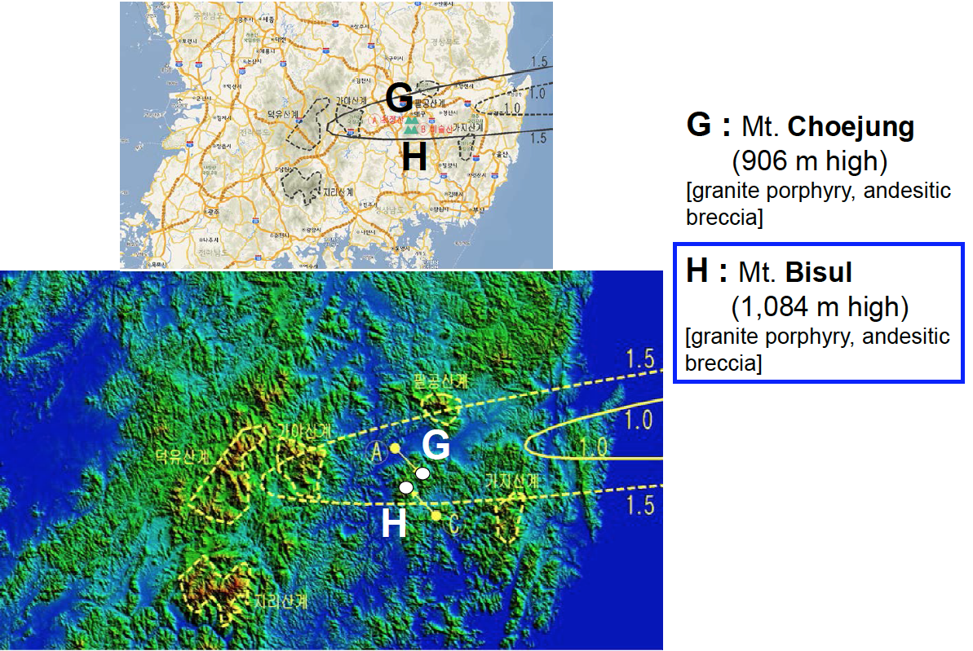
Candidate sites in Korea (OA 1~1.5º)

Slide 38
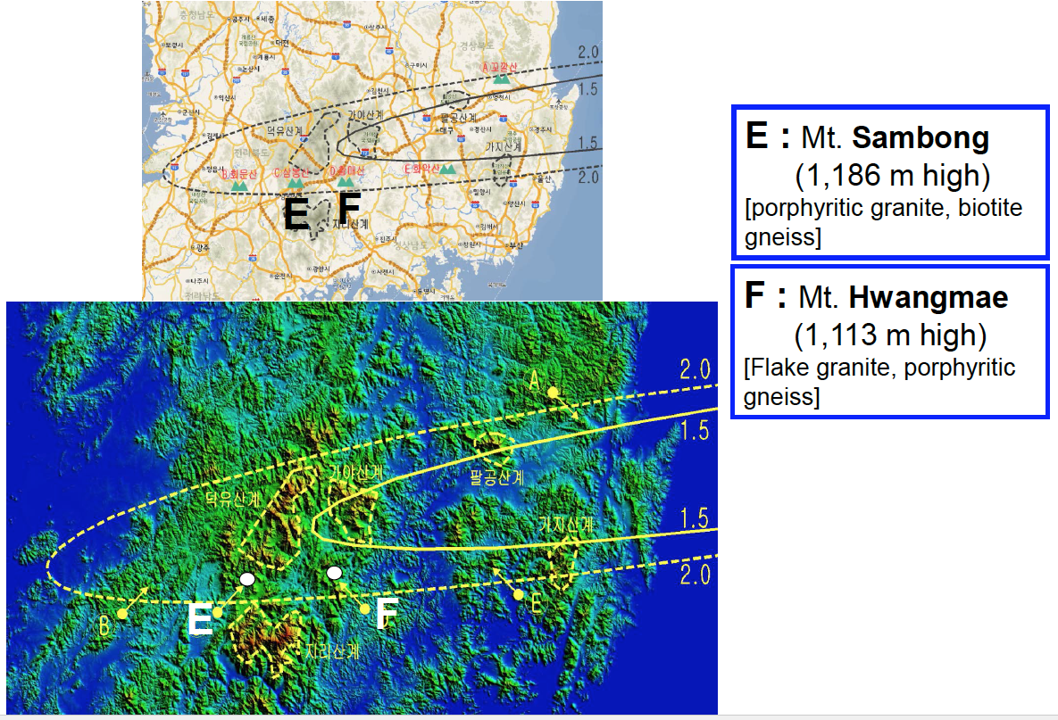
Candidate sites in Korea (OA 1.5~2.0º)

Slide 39
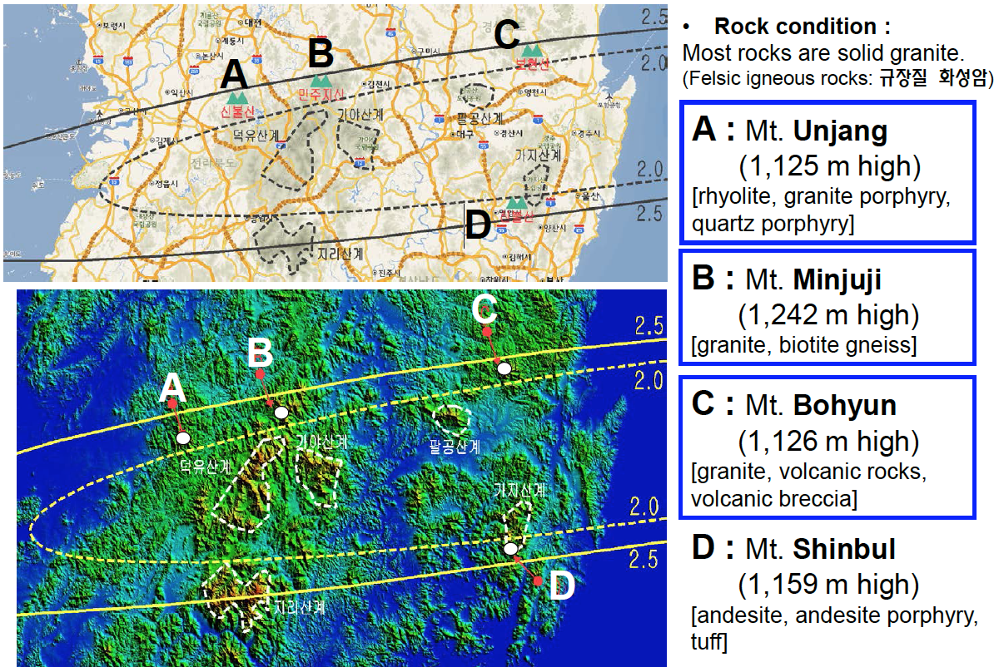
Candidate sites in Korea (OA 2~2.5º)

Slide 40
Summary on candidate sites in Korea
Site candidates for a 2nd osc. maximum detector in Korea
  -- Baselines with 1,000~1,200 km
  -- 2.0~2.5º or 1.5~2.0º off axis beam directions
  -- >1,000 m high mountains with hard granite rocks
Site | OAB | Baseline [km] | Height [m]
Mt. Bisul | ~1.4º | 1080 km | 1084 m
Mt. Hwangmae | ~1.8º | 1140 km | 1113 m
Mt. Sambong | ~1.9º | 1180 km | 1186 m
Mt. Bohyun | ~2.2º | 1040 km | 1126 m
Mt. Minjuii | ~2.2º | 1140 km | 1242 m
Mt. Unjang | ~2.2º | 1190 km | 1125 m

Slide 41
Plans & Strategy
We will form a T2HKK working group.
→ Please joint us if you are interested.
We plan to have a international workshop on T2HKK
this Fall in Korea.
** With well known technology we can/should push this
ASAP. We may get very interesting results much earlier.

Slide 42
To-do List
Implement δcp precision sensitivity
Implement systematic errors on:
  Electron (anti)neutrino cross-section uncertainty
  Energy scale
  non-QE fraction of the CC cross-section
  Backgrounds
Study exposure dependence of sensitivities
Other physics studies

Slide 43
Event Rate Calculation
Currently using NEUT 5.3.2 based MC
  Need to scale by 1.37 to get rates consistent with NEUT 5.1.4.2 based MC in HK documents
2.7e22 POT, 1:3 ν/ν-bar (FHC/RHC) operation ratio
187 kton fiducial volume (compared to 22.5 kton for SK)
Baseline to Korea is 1100 km
Oscillation parameters:
Notes:
2.7e22 POT = 10 years of data with 1.3 MW beam

Slide 44
Summary & Conclusion
T2HKK is an interesting option to resolve the oscillation parameter degeneracy based on the longer baseline and an additional, identical detector (0.25 Mt) in Korea.
Korea has many options for proper sites w/ 1~2º OAB.
We can build T2HKK and do better physics.
T2HKK needs further tuning of some of parameters such as detector mass, baseline, off-axis angle, etc.
T2HKK needs a study on more physics opportunities.
T2HKK needs you! & Let’s focus on science.

Slide 45
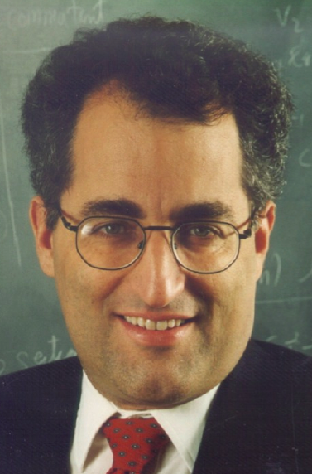
E. Witten
“Why don’t you bring one of the 2 tanks to Korea ?”
@EPP2010

