Slide 1
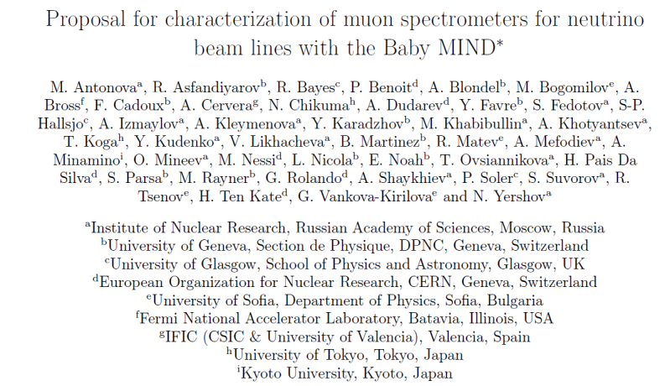
Baby-MIND and the CERN neutrino platform

Slide 2
Historical Introduction
At the occasion of the International Scoping Study for neutrino detectors, (2005-2008) the need for state-of-the-art prototypes of
-- totally active scintillator detectors (TASD) and Liq. Argon detectors , in magnetic field
-- magnetized iron neutrino detector (MIND)
was emphasized, for measurement of the charge separation for electrons and muons.
TASD and MIND were included in the AIDA EU-FP7 program in 2009
Also, an infrastructure for test and development of neutrino detectors was requested.
Today:
A Baby-MIND detector will be tested at CERN
and deployed as part of the WAGASCI experiment in T2K ND280 pit
It is built in the framework of the CERN neutrino platform

Slide 3
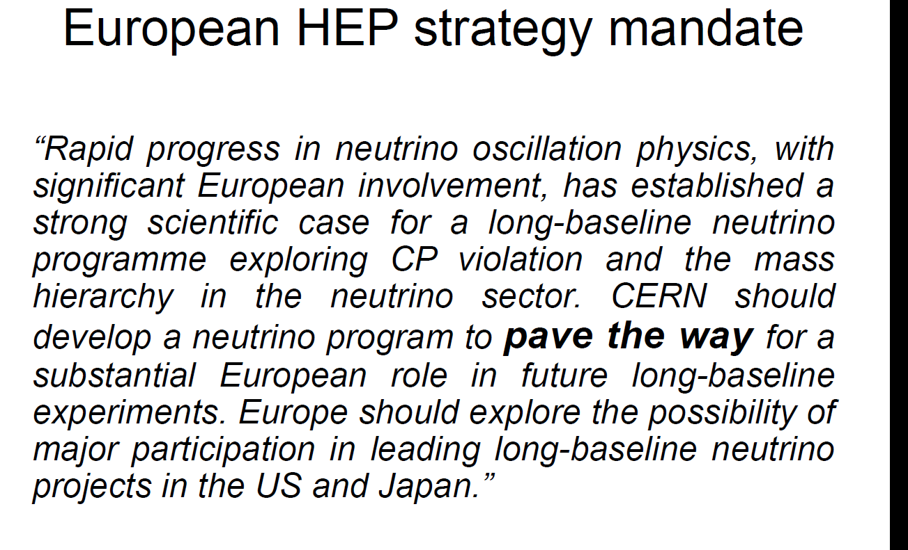
M. Nessi, 3d International
meeting on neutrino infrastructures
30-31 May 2016

Slide 4
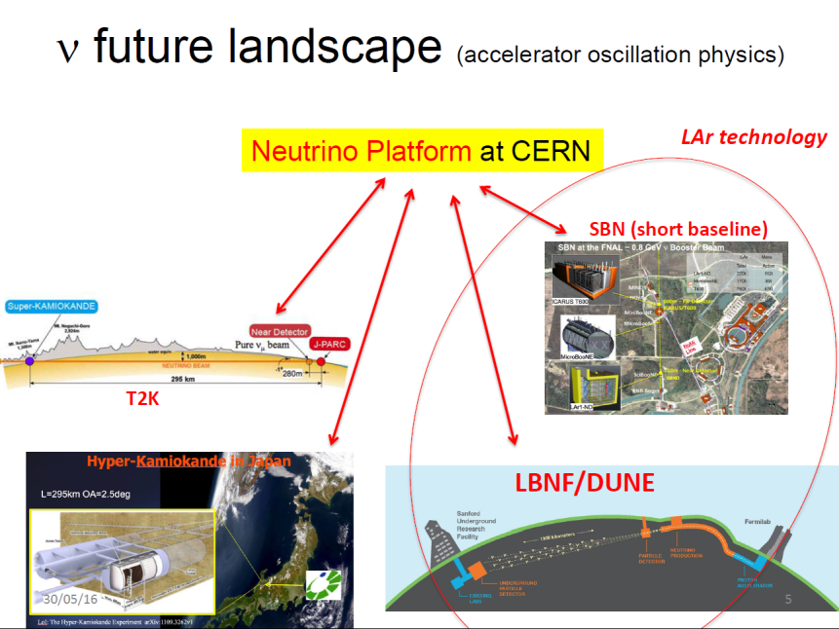
M. Nessi

Slide 5
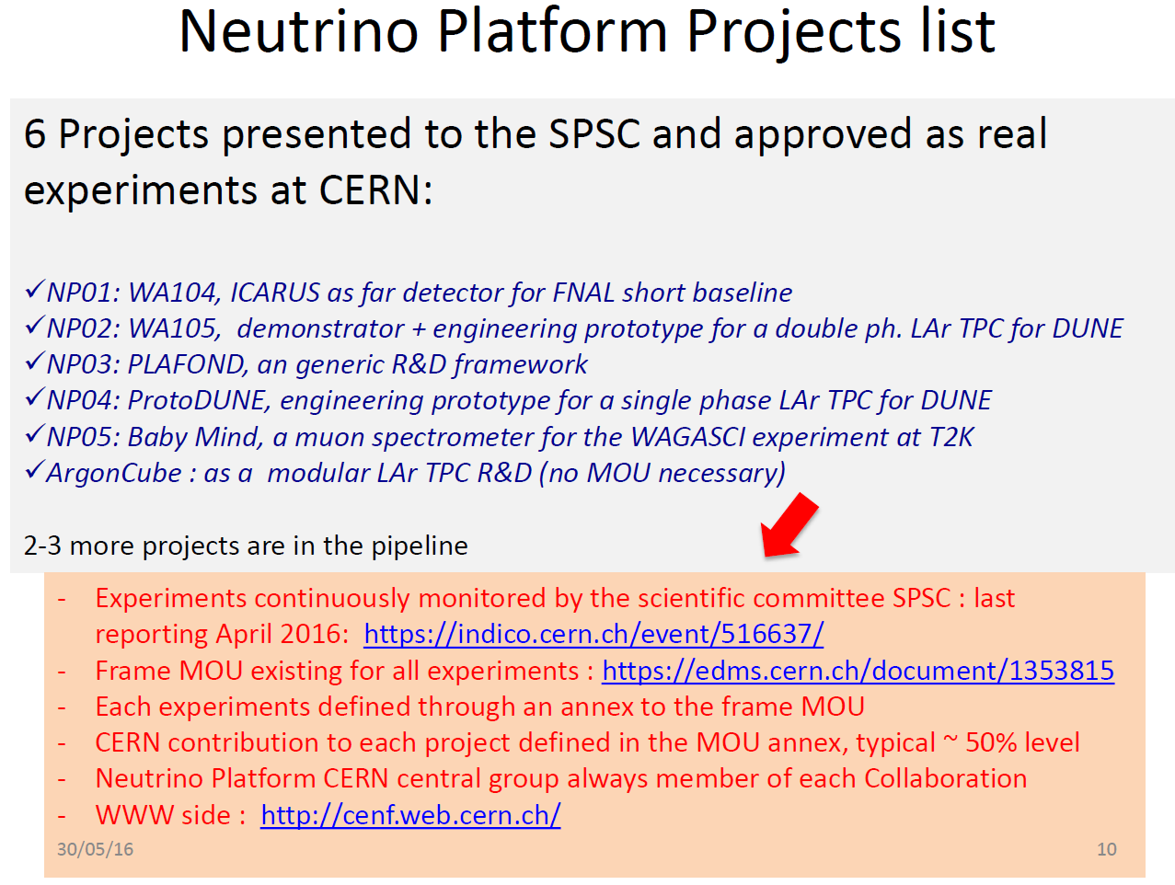
M. Nessi

Slide 6
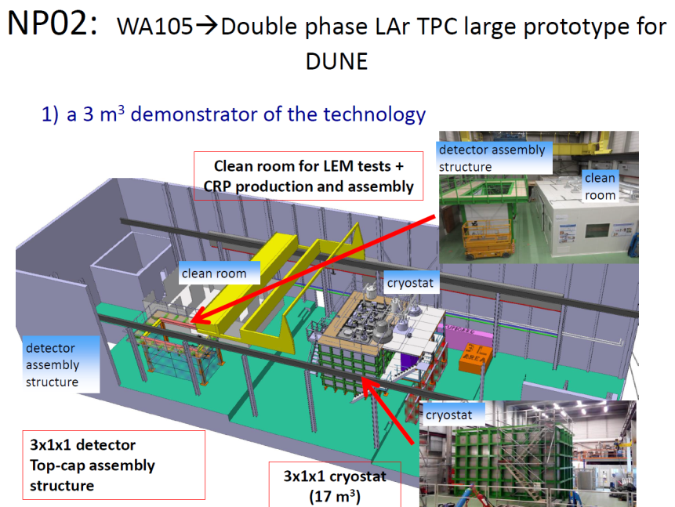
M. Nessi

Slide 7
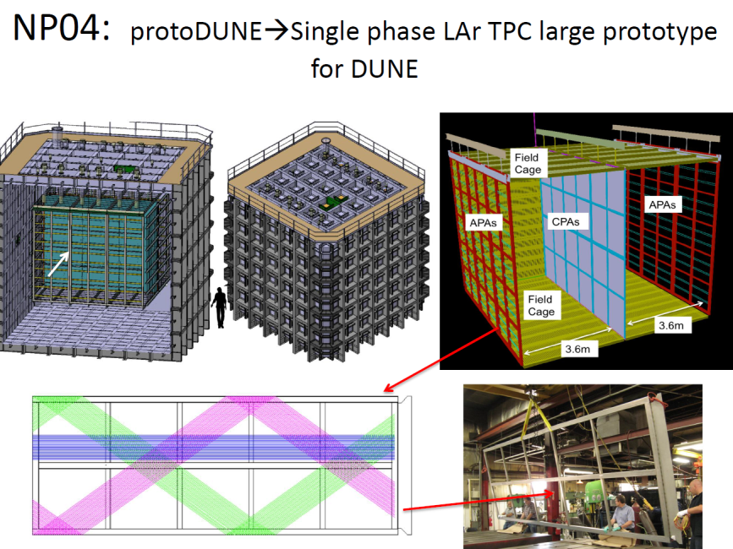
M. Nessi

Slide 8
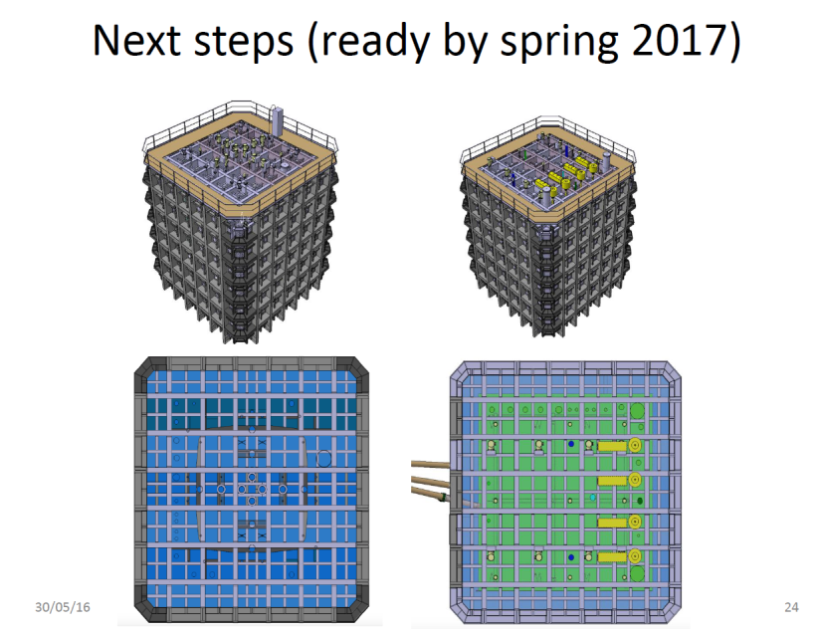
M. Nessi

Slide 9
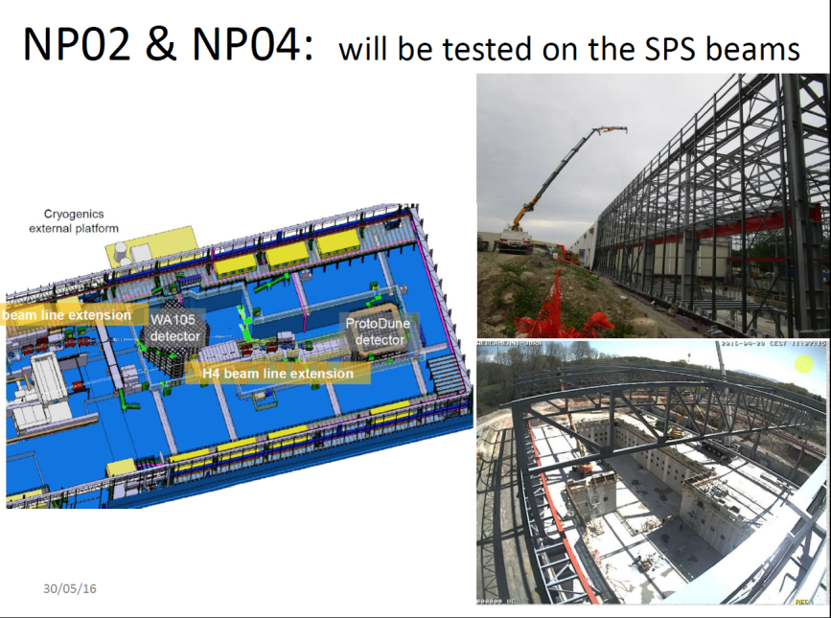
M. Nessi

Slide 10
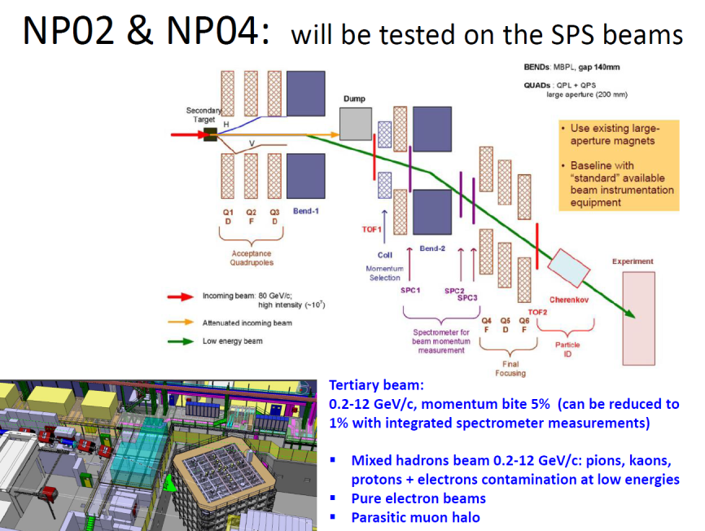
M. Nessi

Slide 11
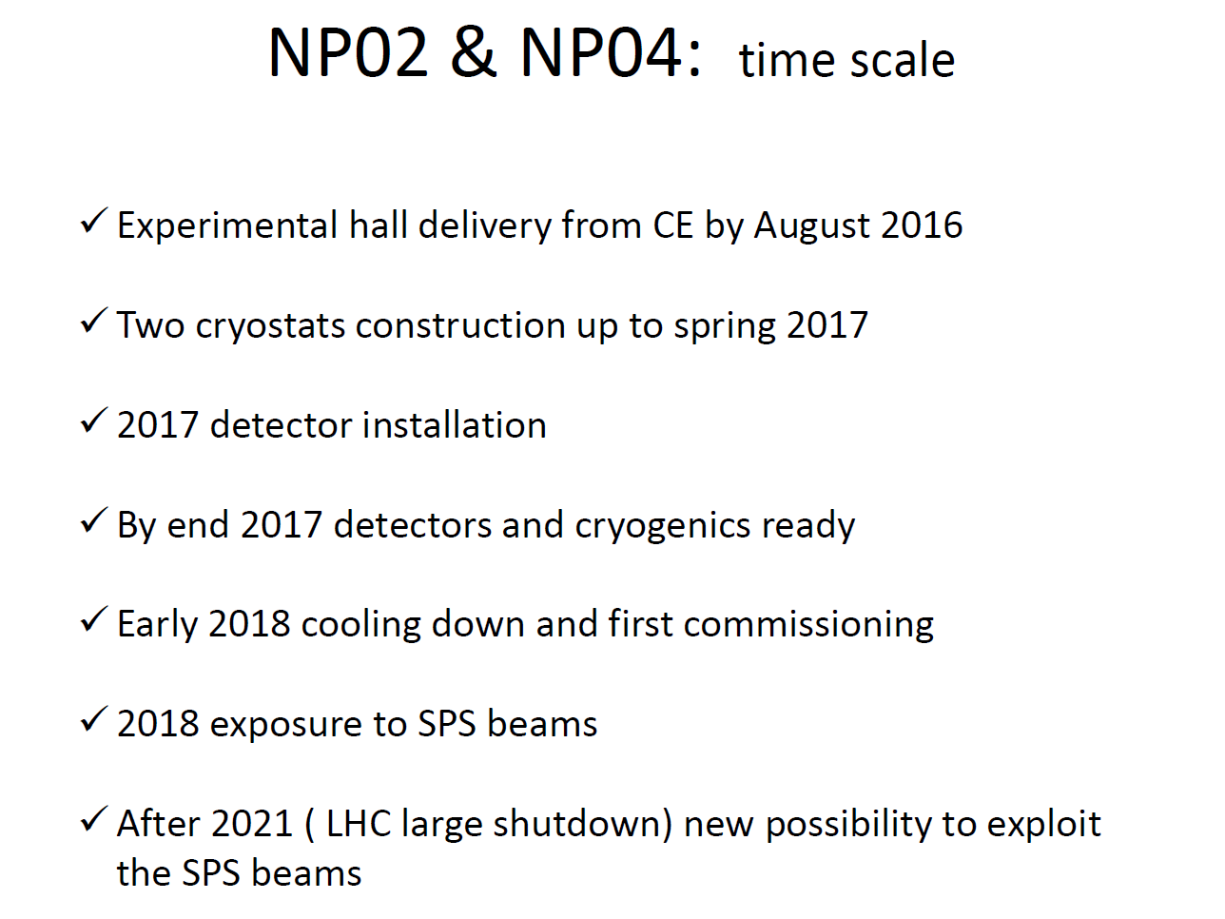
M. Nessi

Slide 12
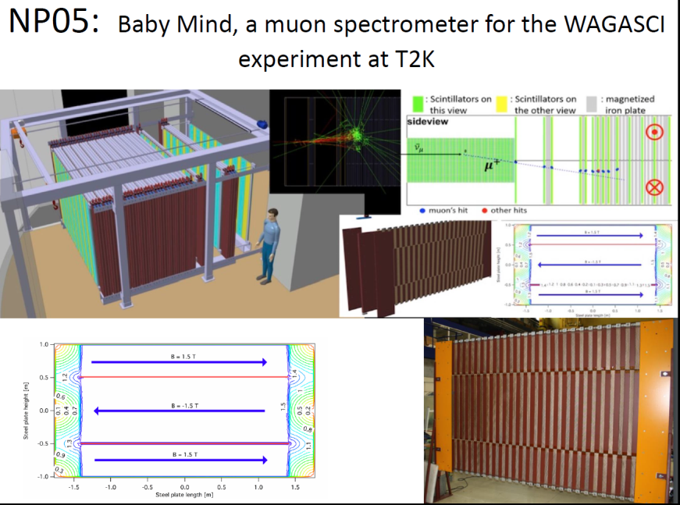
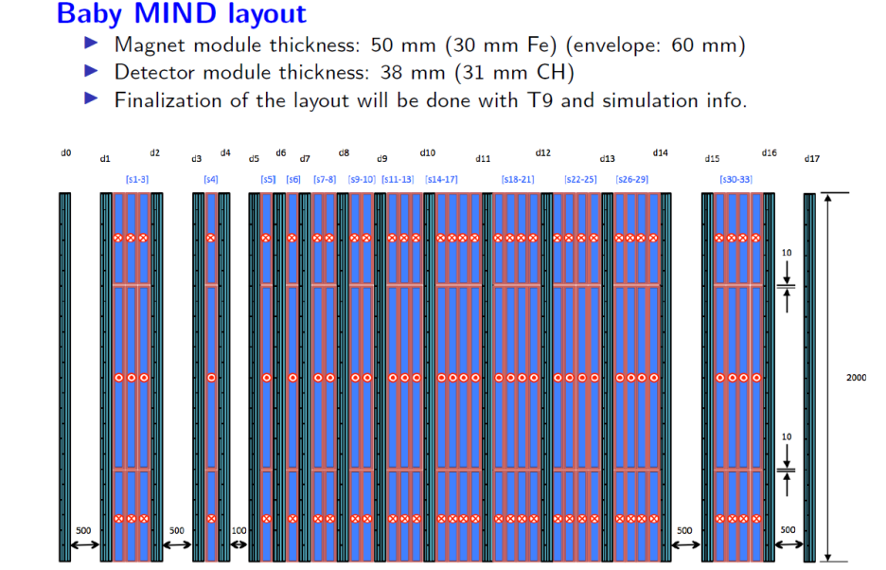

Slide 13
Multiple scattering vs bending
Δθ_{MS} = 0.015/P . √ L/X₀ = 0.034/P for 9cm of iron
θ_{B} = L x 0.3x B /P = 0.04/P for 9cm of magnetized iron at 1.5 T.
-- Same scaling with P
-- Efficiency begins below 300 MeV/c to penetrate 9cm of iron.
-- Improves when L increases if more sampling points are provided.
➔ provided angles are measured before and after the iron plate

Slide 15
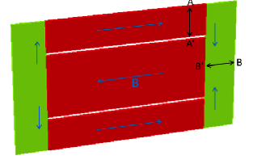
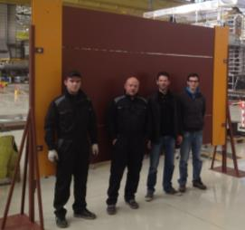
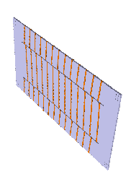
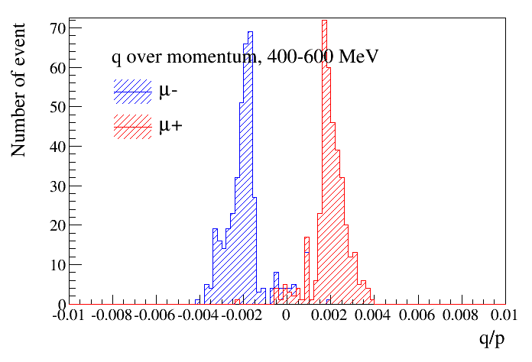
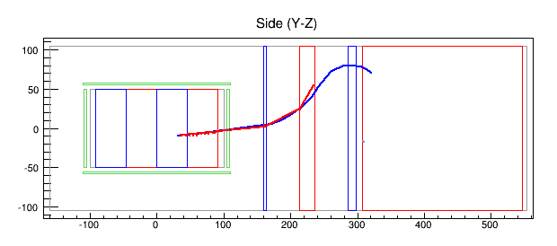
The magnetic design has been elaborated in collaboration with CERN (A. Dudarev);
Requirements in magnetic field (1.5 T), space and power consumption.
2015,
A. Dudarev
Layout is power efficient and
provides
-- homogeneous field.
-- little dead space in end plates
-- sign symmetry between
μ⁺ and μ⁻
89% sign separation for
muons entering front face of
Baby-MIND → 300 MeV/c
(will improve further by fid. cuts)

Slide 16
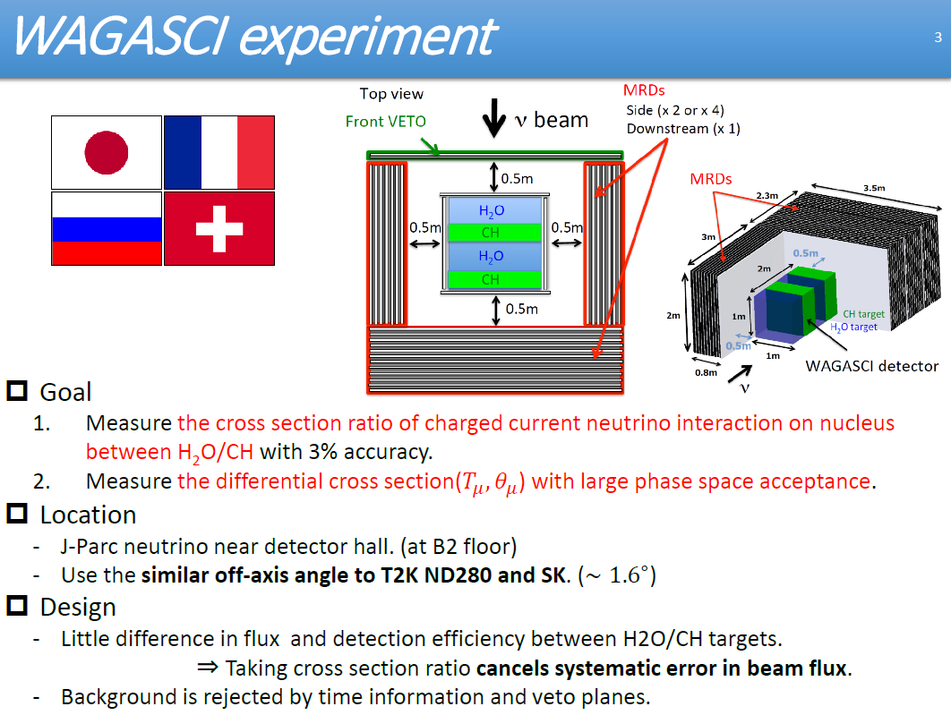
Baby-MIND
+ more
>2 ton target
Magnetized MRD
(Baby-MIND)

Slide 17
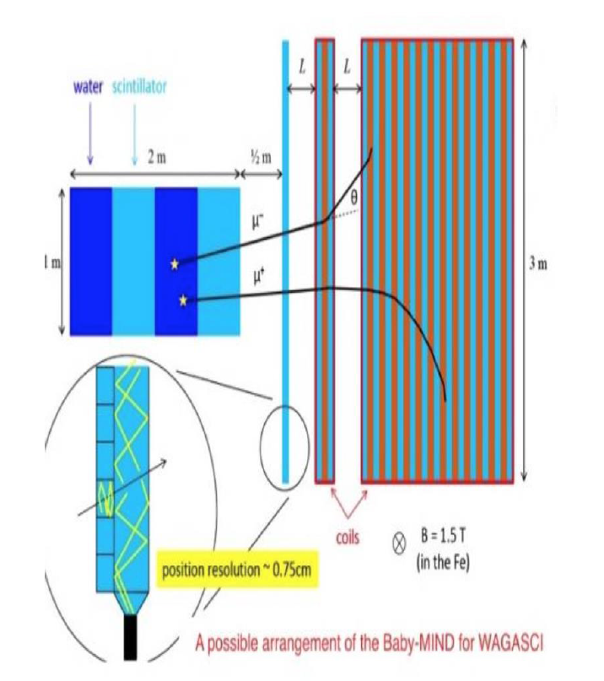

Slide 18
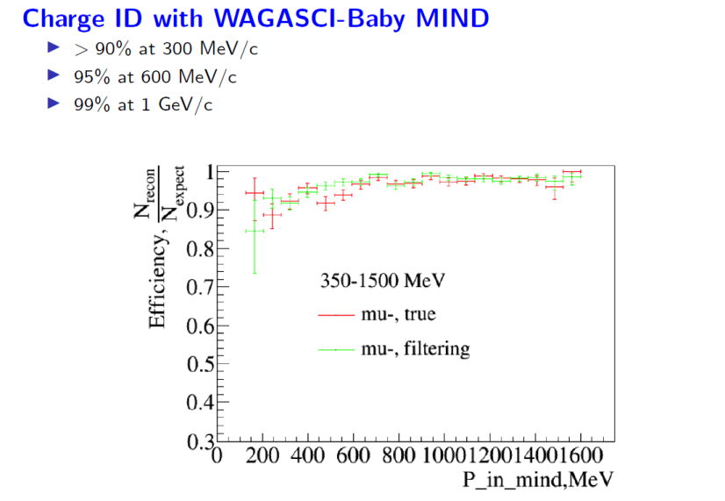
This efficiency can be calculated and will be measured precisely.
Low momentum range !
good candidate for Muon detector in HK Intermediate water detector
other applications (muon spectrometer for HP TPC in T2K(?), DUNE near detector, etc…)

Slide 19
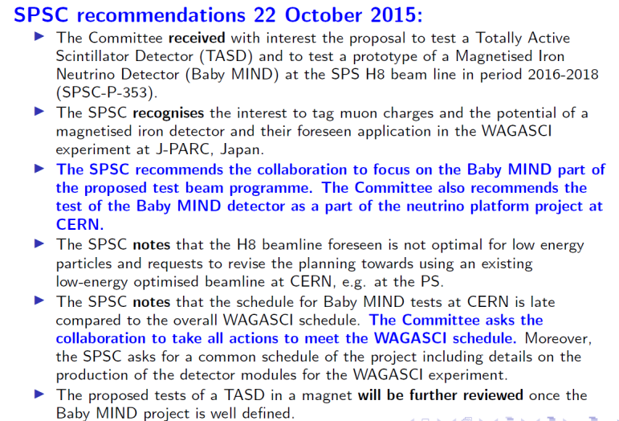

Slide 20
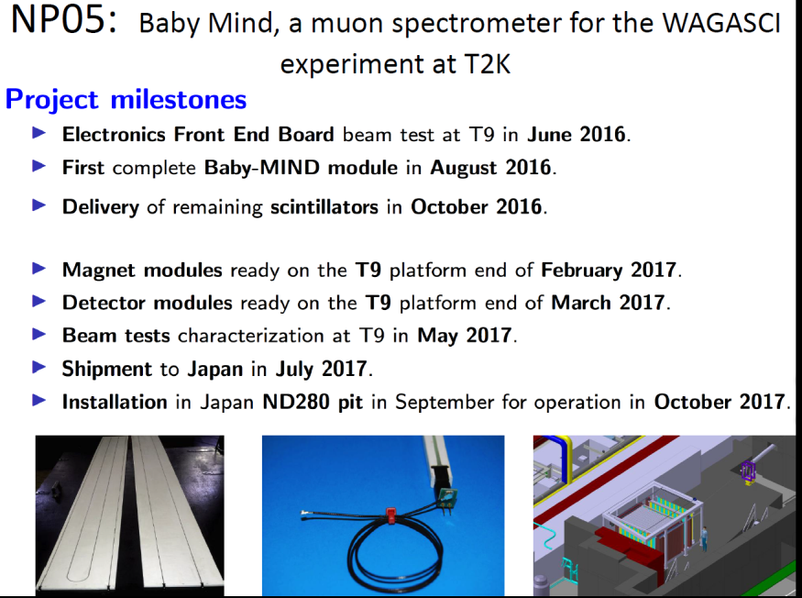

Slide 21
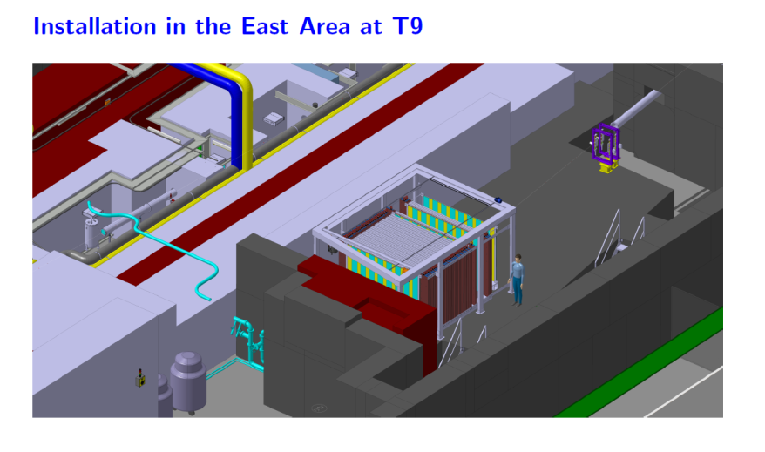
Detector will be assembled in this platform in the east hall in Q1(winter) 2017
Test in beam in May 2017, then packed and shiped to
ND280, J-PARC, Tokai-Mura, Ibaraki Prefecture, Japan

Slide 22
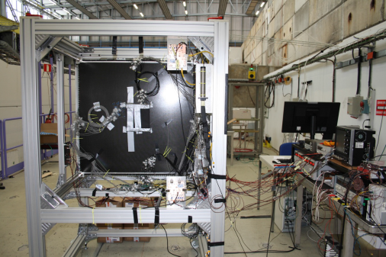
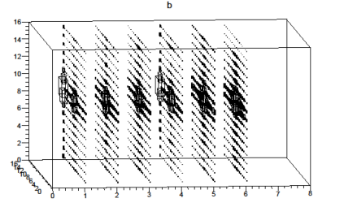
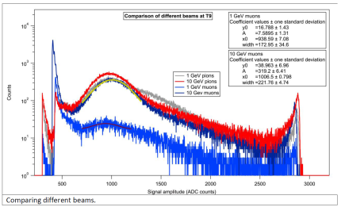
beam test on T9
prototype detector in T9, 28 June 2016
384 channels equipped, 4 FEBs
Advantage of being in East area instead of
North area:
-- beam already available,
-- low energy beams much easier
from PS beam (24 GeV) than SPS (450 GeV)

Slide 23
Baby-MIND status (July 2016)
NP05 The Baby MIND was approved by the CERN Research Board on 9 December 2015
as an R&D project at the Neutrino Platform and is now listed as NP05.
Magnet modules: design is complete. A functional prototype has been assembled.
Procurement of all components is underway and on schedule to meet milestone Dec ’16
Scintillator modules: design is complete. Production is responsibility of INR:
50% of scintillator bars delivered. 100% in October. Mechanics of first 2 modules ordered
and all mechanics ready for Dec. 2016. on schedule.
Electronics: design of Front End Board is complete. First beam test has shown it works,
some issues with timing identified and being fixed. Production in Q4 2016. on schedule
Support mechanics and logistics: Concept for support mechanics in ND280 drafted.
or Japan implementation has been drafted. Detailed design and costing is planned
for late 2016.
Physics simulations: Merging two simulation environments: one developed by
the WAGASCI collaboration derived from the T2K ND280 software
and another developed by collaboration members in Glasgow, the SaRoMan package,
derived from Neutrino Factory and nuSTORM studies.

Slide 24
Other projects for T2K/T2KII/HyperK?
It is clear that CERN Platform is largely committed with the Fermilab LArgon-based program
but encourages more participation to the japanese program.
For instance a TPC-based activity for neutrinos could be undertaken
(T2K upgrade see Marco Zito, also a possible project for DUNE near detector)
-- need to follow some steps
-1. Project reasonably developped and well supported within T2K
-2. Submit a Letter of Intent to the SPSC (next meeting end October, following one in January)
(encouragement by SPSC is important)
Need to specify dimensions, number of channels, requirements, critical items
Time needed for technical design development
etc… and other timelines
-3. Proceed to technical definition towards a proposal, including CERN technical and financial
responsibilities.
-4. location etc… of construction and tests to be discussed as part of the project.
No necessarily located in the north area.

Slide 25
THANK YOU

Slide 26
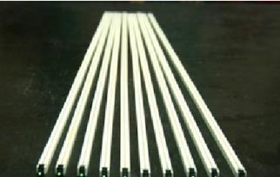

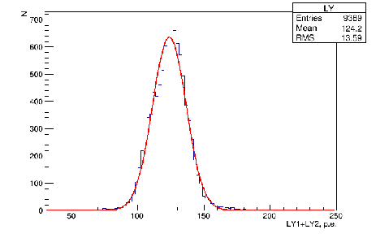
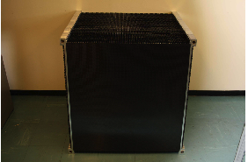
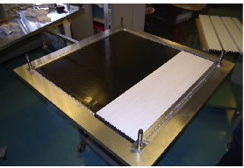
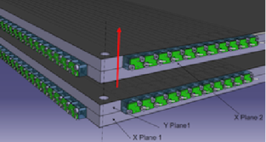
TASD detector
9000 bars of 0.7 x 1.0 x 900 mm³ manufactured & tested
at INR with WLS (Kurarai Y11) fiber and custom designed
connectors to MPPCs
Assembled in 50 alternating x and y planes
readout by 3000 Hammamatsu S12571-025C MPPC
Will read out part of the detector (on beam path)
Mechanical assembly allows for extensible design
with air gaps between planes
-- a cheap way to increase radiation length!
These modules will also serve for 1st test of Baby-MIND
construction ~ complete
← 50 modules in bdg 595
Light yield at INR (70 p.e. /mip)

Slide 27
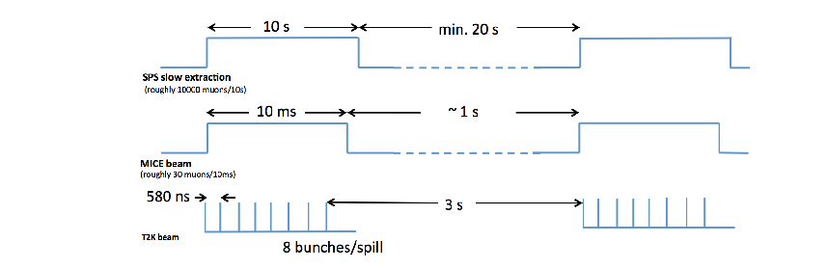
Electronics
The electronics is designed to adapt to the time structures of
-- SPS test beam (typically 10 second slow spill every 0.5 to 1 minute)
-- MICE beam ( 2 ms every 1 to 2.6 second)
-- T2K fast extraction with 8 bunches separated by 580 ns every 2.6 to 1 seconds.
In test beam mode, can record up to 10⁴ events per spill -- or ~10⁷ on a good day.
In MICE or T2K mode, can record all data without dead time.

Slide 28
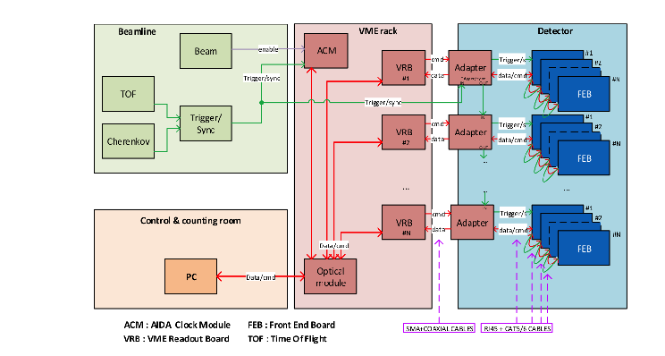
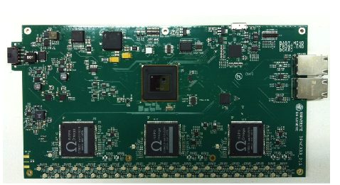
MPPCs
Front-end board
These electronics are
proposed as common tool
for neutrino platform
experiments
(ref. Y. Favre, Neutrino
platform, 3-09-2015)

